Slide 1
Tuesday 23rd March 2021
LO: to understand how beliefs are conveyed
C: Christianity

Slide 2
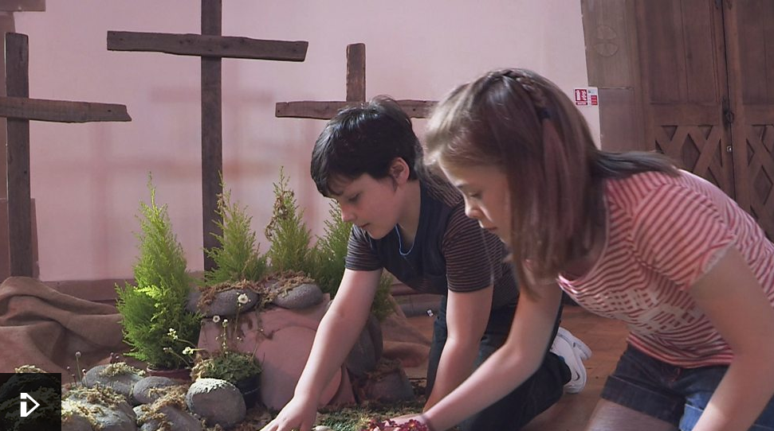
https://www.bbc.co.uk/programmes/p02mww94
As you watch the clip, look out for any actions or objects that have a meaning – ones that are symbols for Easter, for Jesus or for Christian beliefs.

Slide 3
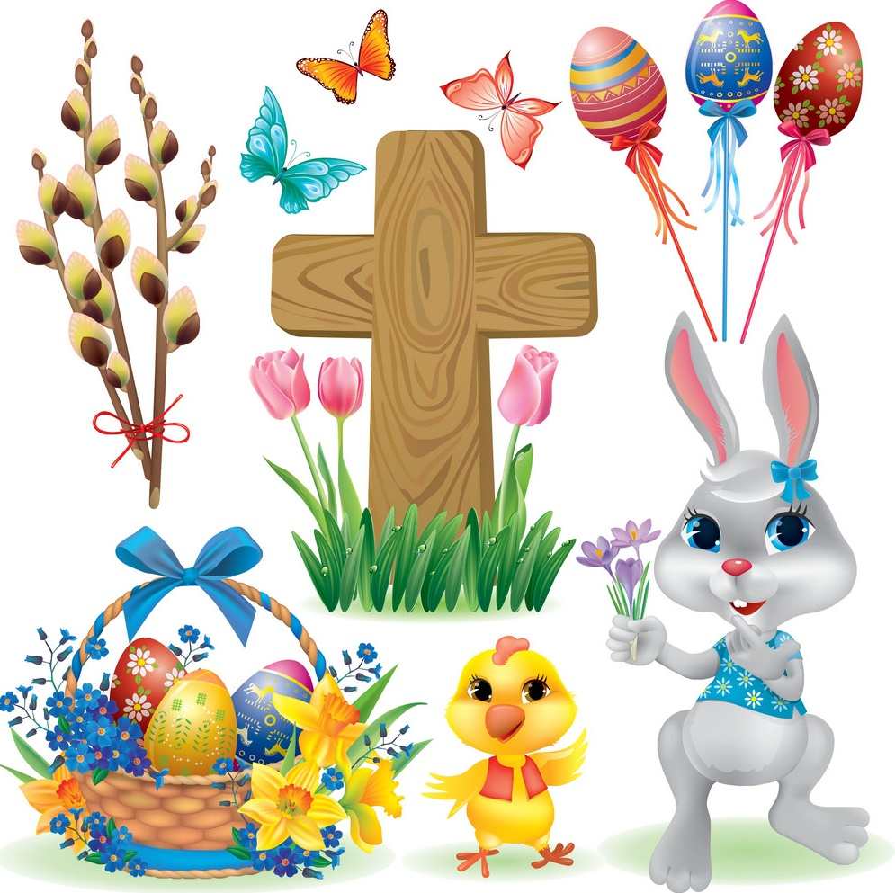
You might have noticed:
Bunnies
Cross
Candles
Jesus on the Cross
Bowing/kneeling
Tomb
Flowers
Praying hands
Chalice
What do these actions mean or symbolise?

Slide 4
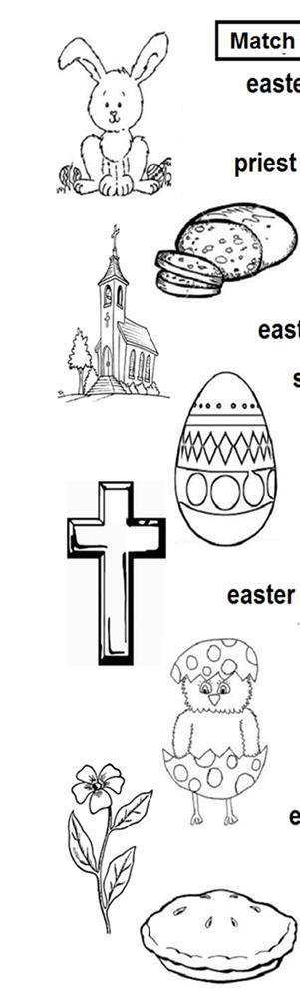
You might have noticed:
Bunnies – Easter and New Life
Cross - Easter and Jesus dying on the cross
Candles – Jesus is the light of the world; a guiding light
Jesus on the Cross – Easter and the crucifixion; Jesus’ sacrifice for the forgiveness of sins
Bowing/kneeling – respecting God and Jesus who are a higher power
Tomb – Easter and Jesus’ death and resurrection
Flowers – Easter and New Life
Praying hands – obedience, sincerity, submission, repentance, worship and respect in regard to God’s higher power
Chalice – Communion; Easter and the Last Supper

Slide 5
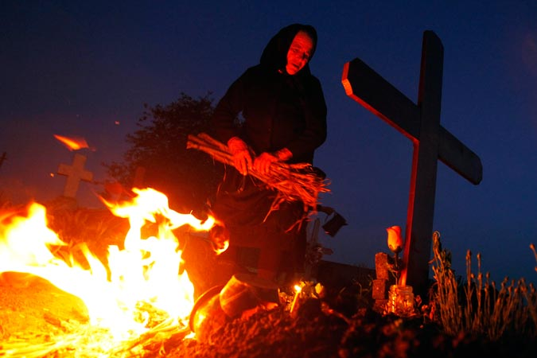
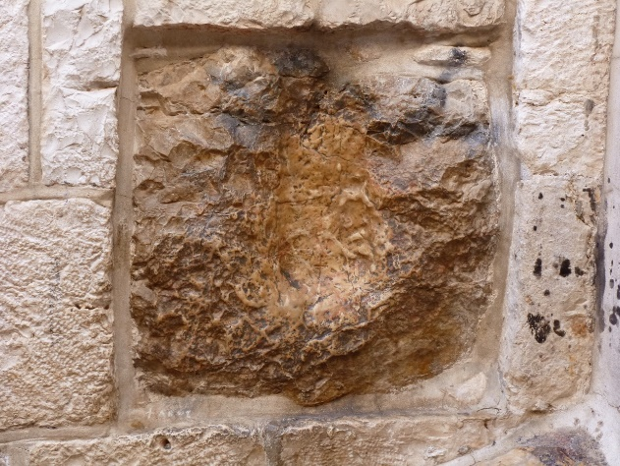
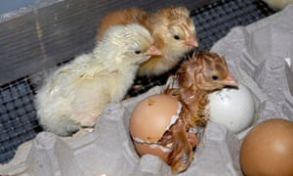
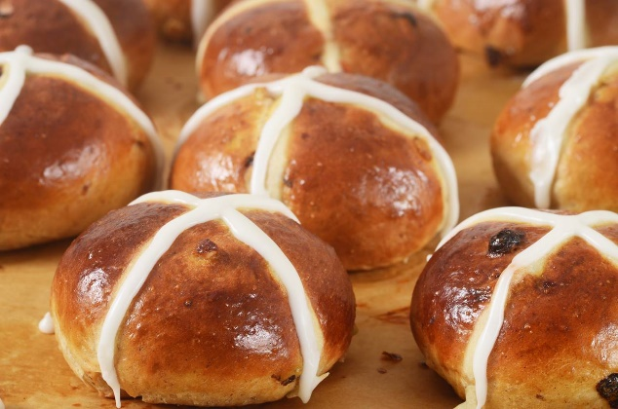
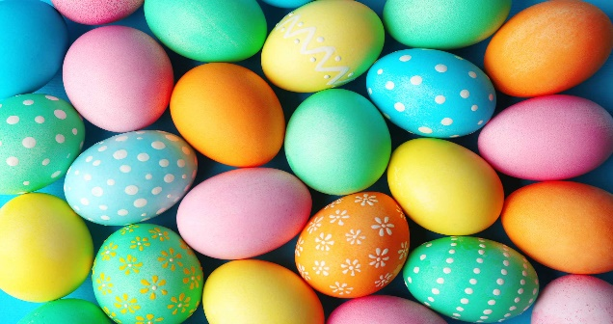
5 symbols from the video clip:
Fire burning on Easter morning
Touching the stone where Jesus fell
Hot cross buns
Easter egg
Chicken born from the egg
What does each symbol stand for or link to?
Which reminders do these symbols provide of the stories of Jesus at the first Easter?
What do they mean for Christians?

Slide 6

Symbolic meaning is complex and not a simple one-to-one code.
Each symbol may have a range of meanings to you and to Christians.

Slide 7
Activity:
Draw pictures of the 5 symbols that we have discussed and annotate each picture with what you think it means or symbolises.
Snorkelling and Diving – challenge yourself to write a detailed explanation of the symbolism. Can you suggest more than one meaning for these symbols?
Red Pen: did you see any other Christian symbols in the video clip? What did they symbolise?

