Slide 1

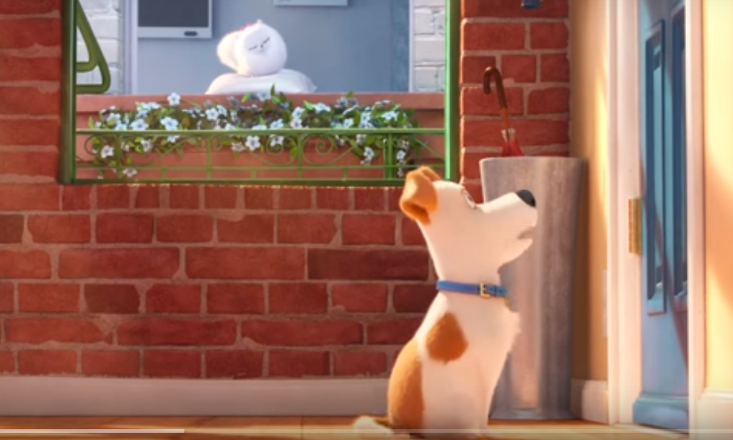



What does the word ‘trailer’ mean?
What is the cat called?
How can you tell that the cat really wants to eat the food?
https://www.youtube.com/watch?v=UZ4WBlveGfw
How does the director surprise us with the dog’s behaviour at the end?

