Slide 1
Tuesday 20th April 2021
LO: to understand electrical circuits
C: Electricity

Slide 2
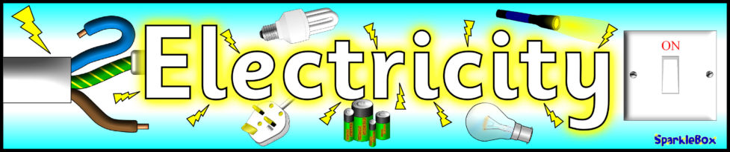
Can you explain what electricity is?
1. As many things as you can that need electricity to work.
2. As many sources of electricity (power) as you can.

Slide 3
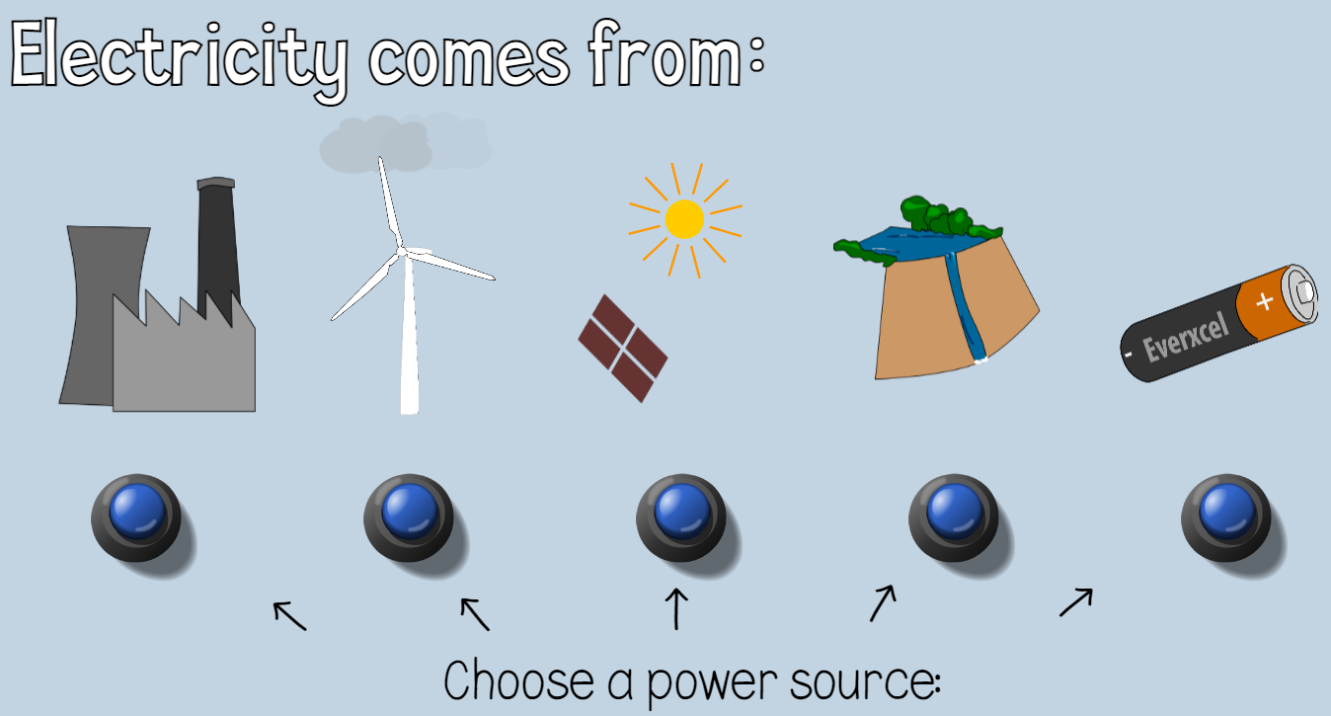
http://www.switchedonkids.org.uk/what-is-electricity
What fuels might be used in the power station?
Choose a power source to see how electricity travels from where it is generated via a pylon and a substation to our homes.

Slide 4
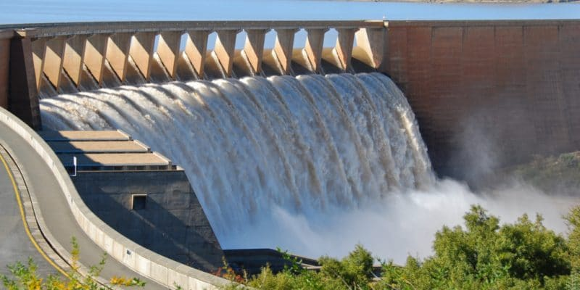
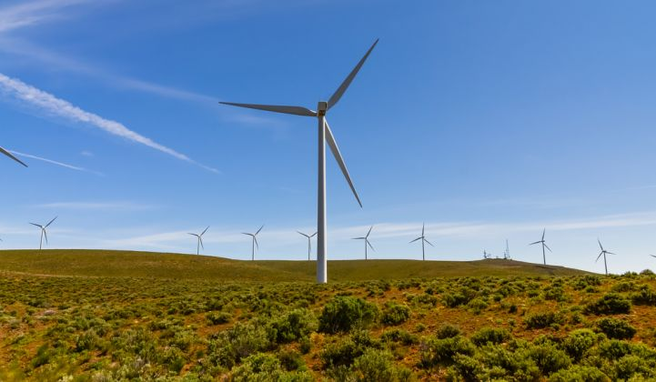
https://www.bbc.co.uk/bitesize/clips/z9t9mp3

Slide 5
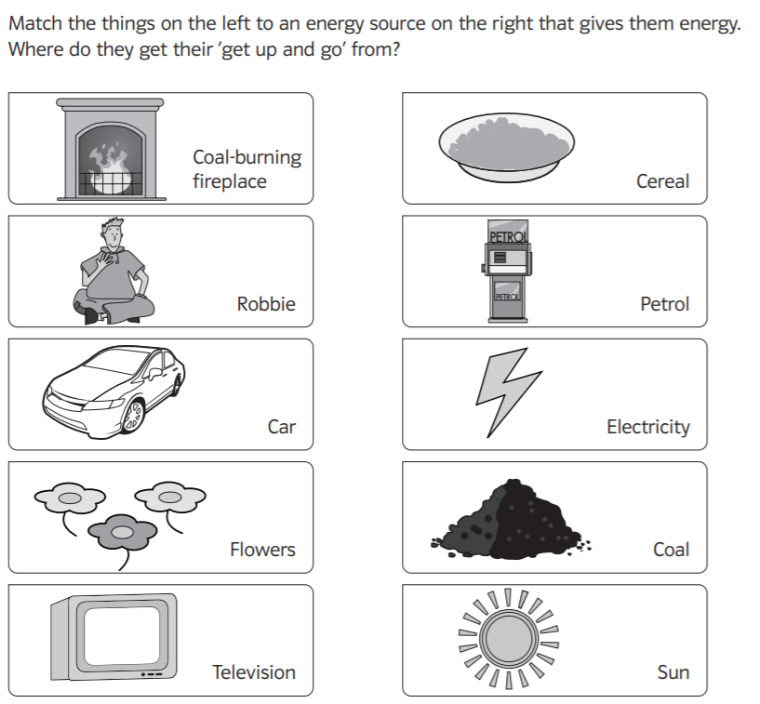

Slide 6
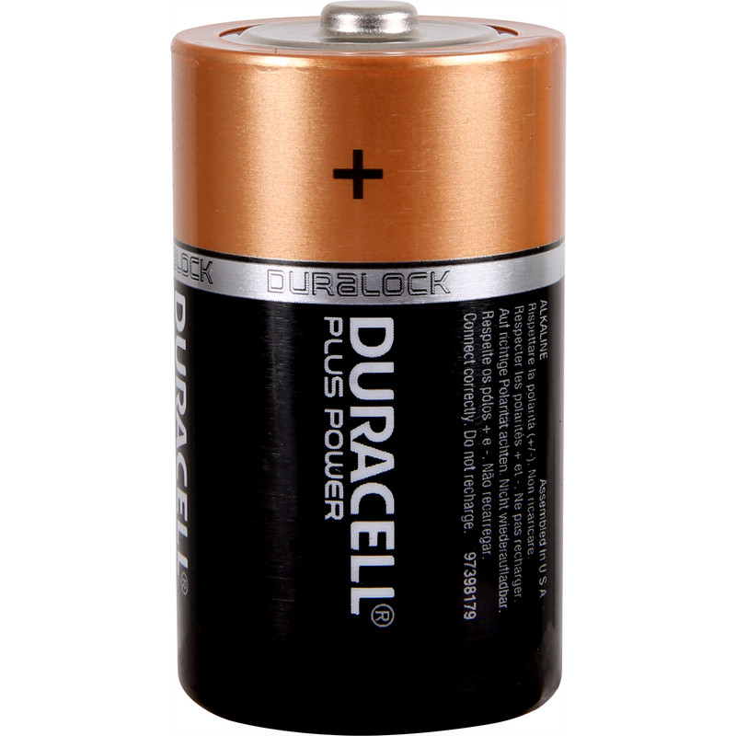
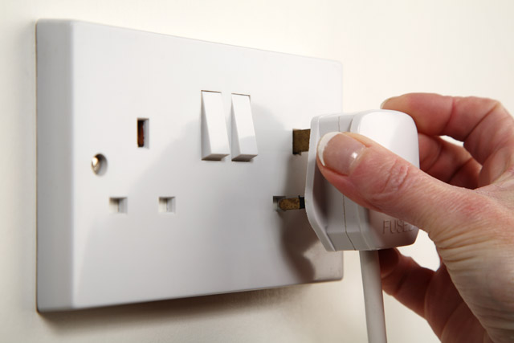
We will be focusing on energy from batteries and mains electricity.
Think of some appliances (found at home) that get their energy from mains electricity
Can you think of any more?
What about devices that run on battery power?
Batteries
Mains

Slide 7
What is different about them?
Battery powered objects are generally smaller, are portable and often need to be charged, whereas mains powered objects are generally larger, not portable and need to be plugged into a mains socket.

Slide 8
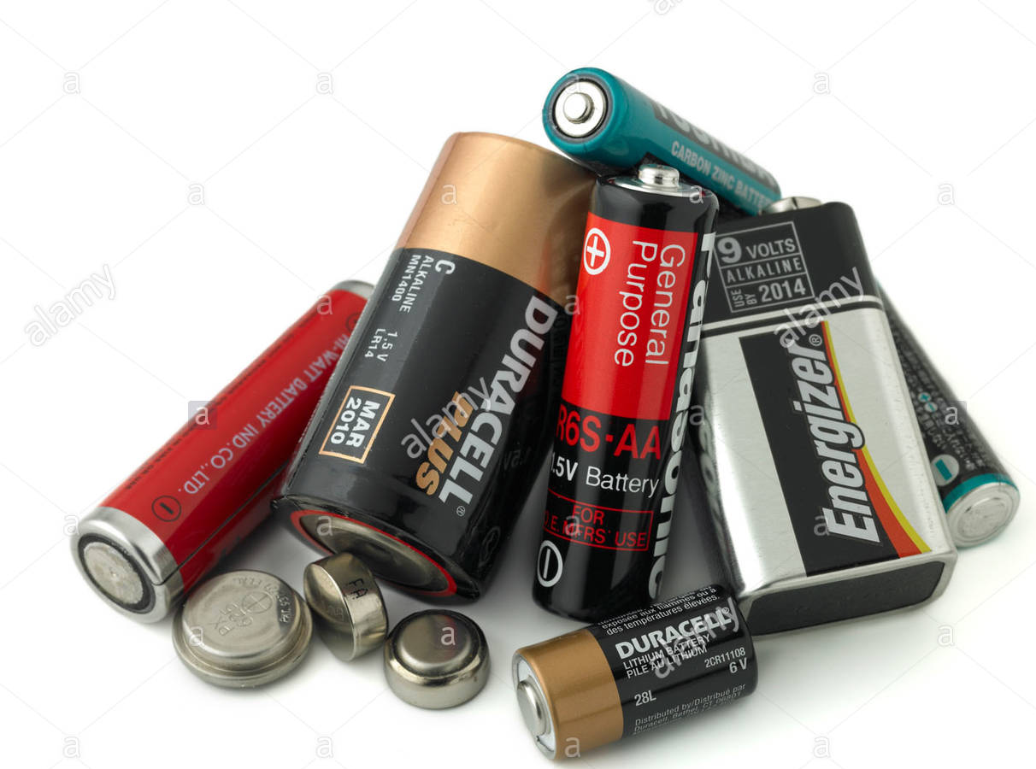
Batteries are powered by chemicals inside them reacting to produce a current.
Different batteries have different voltages –the higher the volts, the more power the battery has.
Voltage in batteries is much lower than in the mains and this makes them less dangerous, though it does not make the completely safe, so we still shouldn’t play around with them!

Slide 9
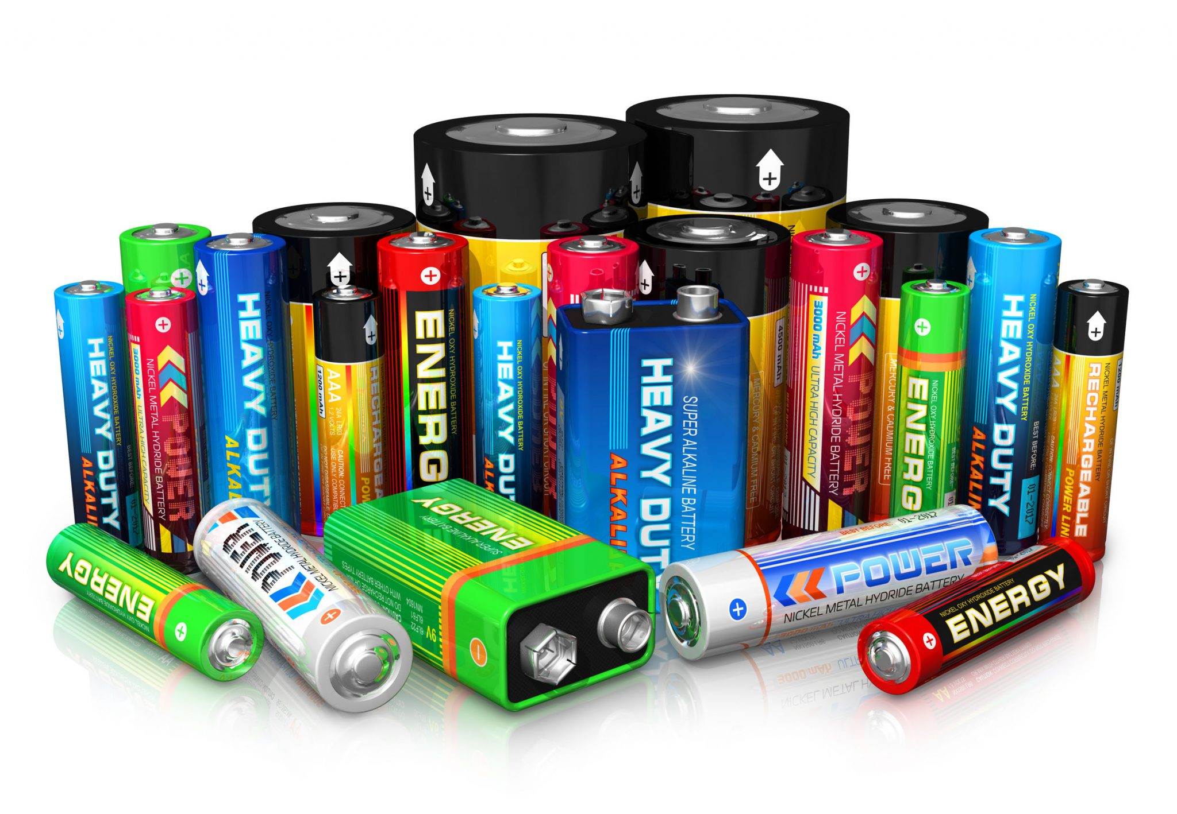
https://www.bbc.co.uk/bitesize/clips/zh79wmn

Slide 10
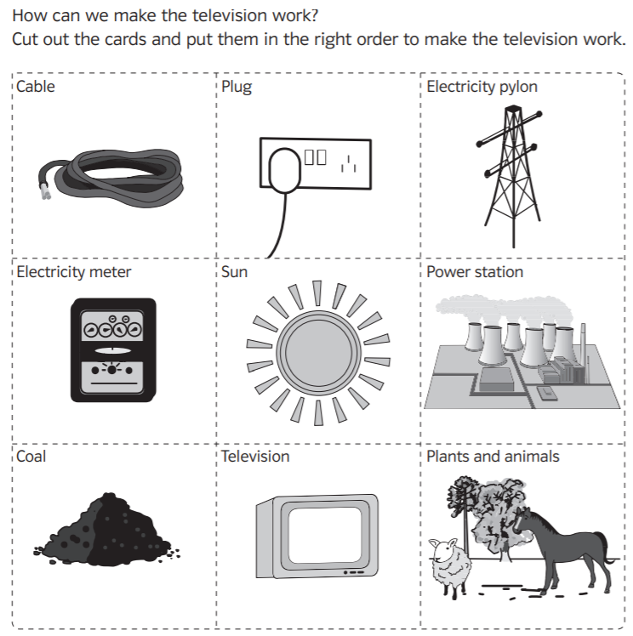
Activity 1:
Complete the cut and stick activity.
Snorkelling and Diving: write an explanation underneath each of the pictures to show your understanding of where electricity comes from.

Slide 11
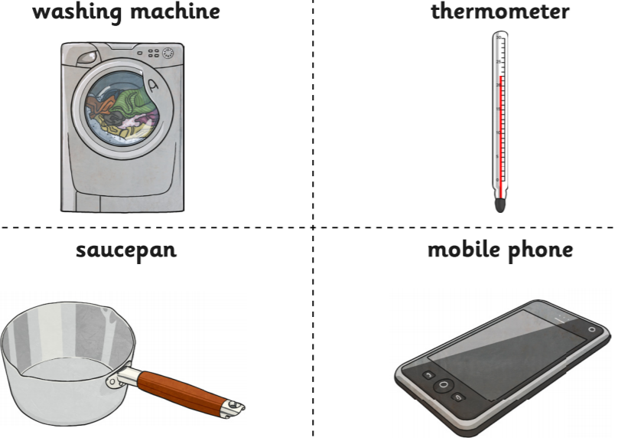
Activity 2
Using the appliance cards, complete the Mains or Battery? Activity.
Paddling: complete the activity in a table; decide if each appliance uses mains or battery electricity.
Snorkelling: complete the activity in a Venn diagram; decide if each appliance uses mains electricity, batter or both.
Diving: complete the activity in a Venn diagram; decide if each appliance uses mains electricity, battery, both or neither.
Extension: can you give your own examples of appliances that fit into these categories?

Slide 12
Red Pen
Amy says, ‘Electricity just comes out of plugs.’
Do you agree?
Explain your reasoning.

Slide 13
Plenary:
Remember: plugs on appliances at home must not be ‘played’ with.
Anything provided in our classroom is safe to play with!
Electricity just comes out of plugs.

