Slide 1
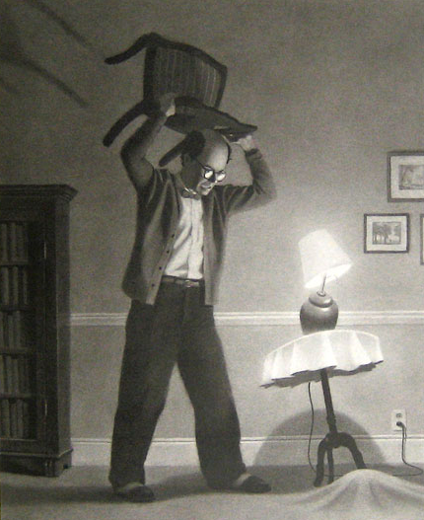
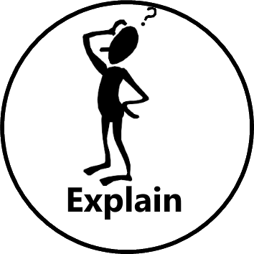



What does the word ‘threatened’ mean?
What is the man holding?
What do you think is under the carpet?
Why hasn’t Chris Van Allsburg shown you what’s under the carpet?
Taken from The Mysteries of Harris Burdick by Chris Van Allsburg

