Slide 1
Monday 26th April 2021
LO: To write with purpose.
To use sentences appropriately.
C: Instructions

Slide 2

What is a verb?

Slide 3
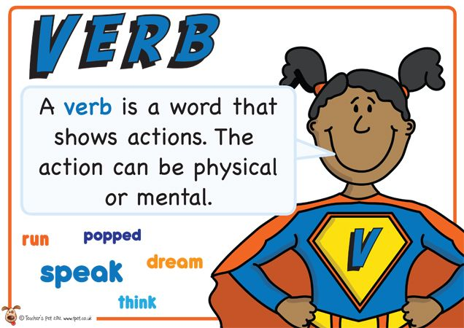
A verb is a doing word.
It expresses a physical action, a mental action or a state of being.

Slide 4
Have a look at these words.
Which words are verbs?
have | colour | straight | look | strong | cube
chew | air | square | easy | pink | table
tooth | hair | say | date | blonde | box
long | salt | alone | circle | sweet | work
bored | burger | orange | enjoy | heart | cry
sky | in | clock | earring | hear | day
sleep | make | run | long | hat | take
huge | watch | funny | dark | nail | talk
short | floor | weak | screen | tall | break
eye | sour | do | shirt | eat | white

Slide 5
Did you find all of the verbs?
have | colour | straight | look | strong | cube
chew | air | square | easy | pink | table
tooth | hair | say | date | blonde | box
long | salt | alone | circle | sweet | work
bored | burger | orange | enjoy | heart | cry
sky | in | clock | earring | hear | day
sleep | make | run | long | hat | take
huge | watch | funny | dark | nail | talk
short | floor | weak | screen | tall | break
eye | sour | do | shirt | eat | white

Slide 6
We can add extra information/detail to our sentences by describing our verbs.
Do you know what this is called?

Slide 7
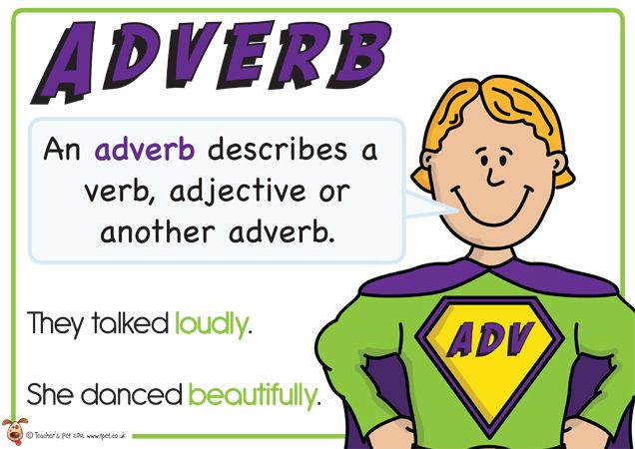
Adverbs!
An adverb tells us more about a verb.
It almost always answers the questions: how? When? Where? How often? And in what way?

Slide 8
Can you think of any adverbs to describe these verbs?
Create a bubble map of your ideas.
have | colour | straight | look | strong | cube
chew | air | square | easy | pink | table
tooth | hair | say | date | blonde | box
long | salt | alone | circle | sweet | work
bored | burger | orange | enjoy | heart | cry
sky | in | clock | earring | hear | day
sleep | make | run | long | hat | take
huge | watch | funny | dark | nail | talk
short | floor | weak | screen | tall | break
eye | sour | do | shirt | eat | white

Slide 9
What do you know about instructions?
What are instructions?
When do we use instructions?
Can you think of any examples?

Slide 10
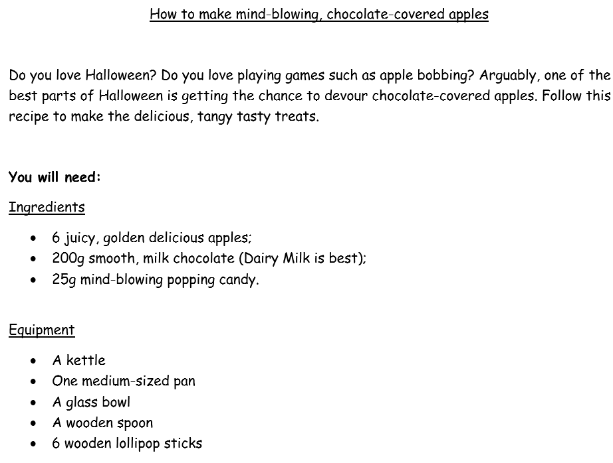
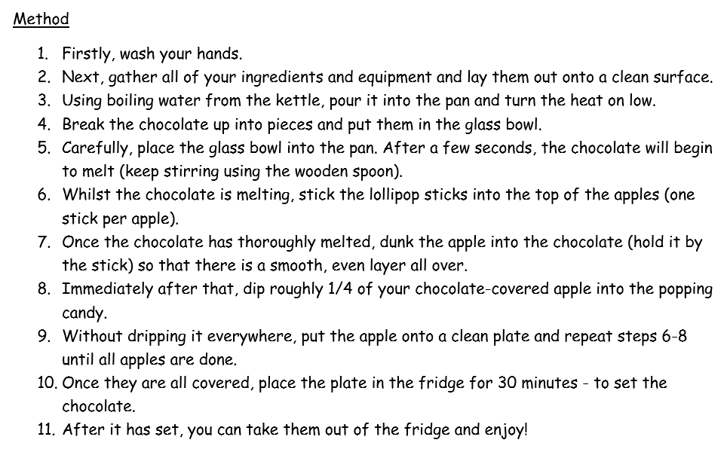

Slide 11
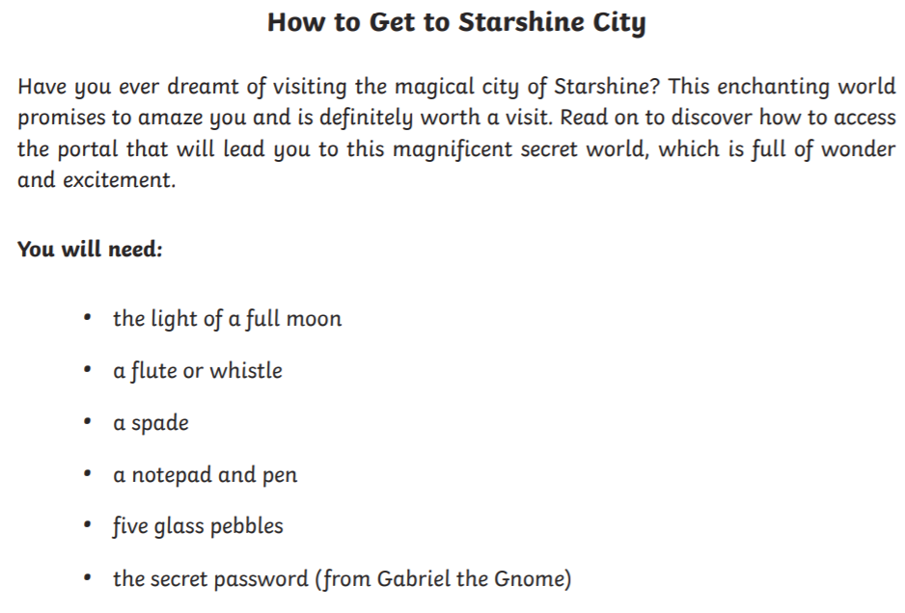
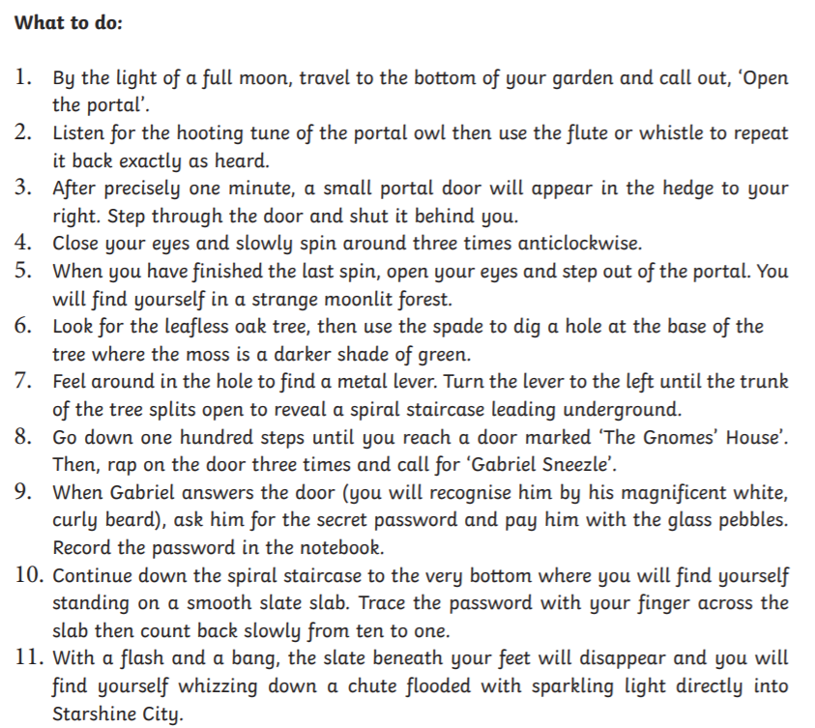

Slide 12
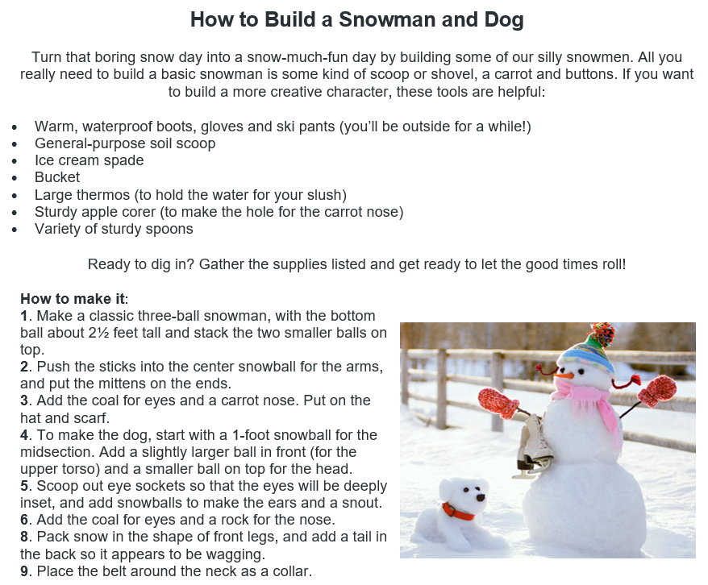

Slide 13
Instructions have a particular purpose, for example recipes, games, directions, how to make something, how to draw something etc.
Look back at the examples and identify the features of instructions.

Slide 14
Features of instructions
Introduction
Imperative verbs
Time connectives
Chronological order
Title explaining the purpose of the text
Diagrams
A list of equipment or ingredients needed
A set of steps to follow

Slide 15
What do you notice about these instructions?

Slide 16
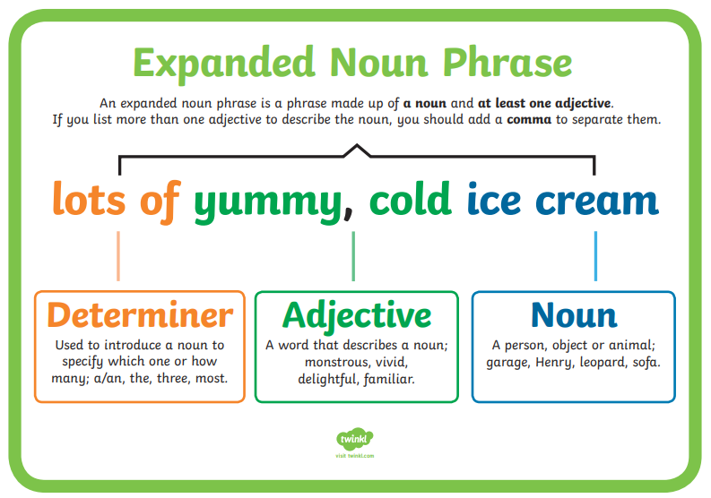
How could you add more detail to the instructions?
Add some expanded noun phrases to the instructions on the next slide!

Slide 18
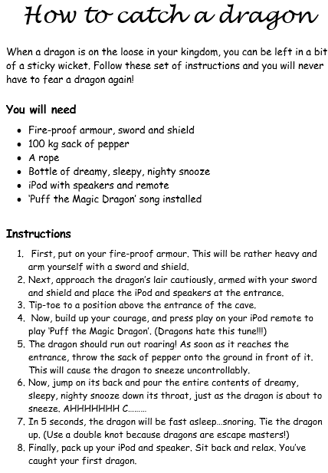
Activity:
Have a look at the instructions.
Use 3 different coloured pencils to highlight or underline:
- imperative verbs
- time connectives
- adverbs
Write additional features of instructions explored today underneath.
Red Pen: add in some expanded noun phrases to your instructions.

Slide 19
Tuesday 27th April 2021
LO: To write with purpose.
To punctuate accurately.
C: Instructions

Slide 20
Present perfect tense
Can you remember anything about this tense?
(We did look at this in lockdown…)

Slide 21
The present perfect tense can be used to describe different actions.
In lockdown, we used present perfect tense to describe an action that started in the past and continues in the present – the destruction of the rainforest.
Today, we are going to use this tense to describe an action when the time is not important or to talk about an experience in a way that does not refer to when they happened.

Slide 22
For example:
Once you have completed your homework, tidy your pencils away.
After you have laid the table, wash your hands.
When you have tucked your chair in, go out to break.
Once you have planted the seeds, wait for the flowers to grow.
After you have played on the computer, go to bed.
When you have finished your dinner, get a bowl of ice cream.
Time is not specified – it doesn’t matter when the action is completed.

Slide 23
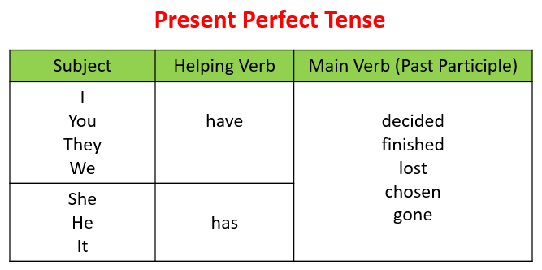

Slide 24
Think of some sentences using the present perfect tense that could be used for instructions.
Use the sentence starters to help you.
After you have…
Once you have…
When you have…
Write a sentence for each sentence starter.

Slide 25

You are going to write your own instructions this week for ‘how to train a dragon.’

Slide 26
What might you have to do to train a dragon?
Create a bubble map of your ideas!
Remember the instructions need to be clear, so other people can follow them and know what do.

Slide 27
What method are you going to use for your instructions?

Slide 28
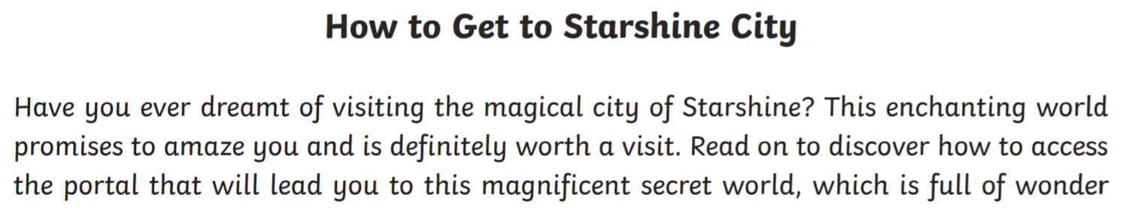
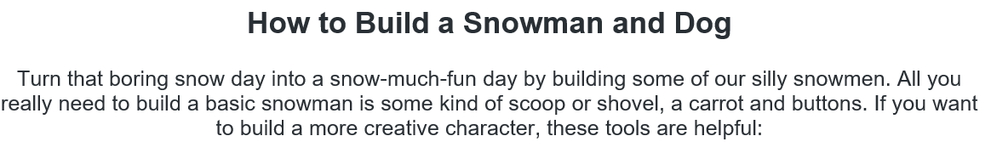
Look at these introductions.
What are the features of introductions?

Slide 29
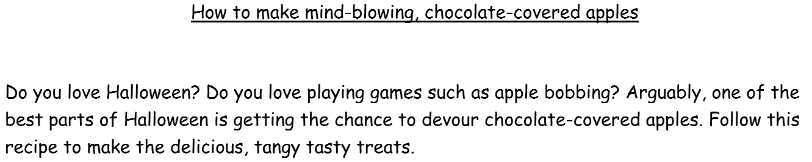
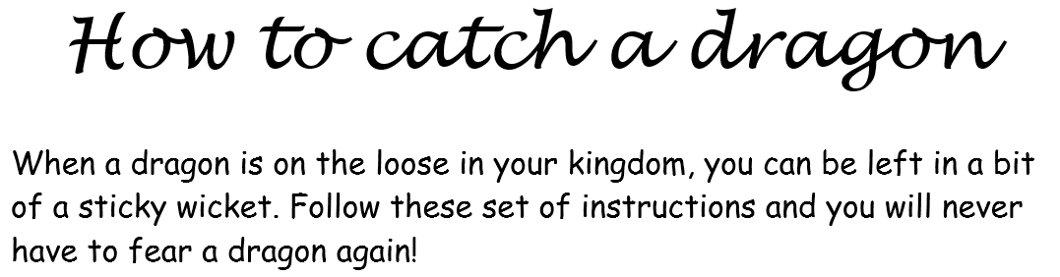
Look at these introductions.
What are the features of introductions?

Slide 30
Activity:
1. Decide on a method for training dragons and write down your idea.
2. Write your own introduction for your ‘how to train a dragon’ instructions.
Paddling: use the sentence starters below to help you.
Have you ever…?
Do you…?
Read on to…
Follow these instructions to…

Slide 31
Wednesday 28th April 2021
LO: To write with purpose.
To use sentences appropriately.
To punctuate accurately.
C: Instructions

Slide 32

Practice saying your instructions out loud to someone today!
Share your instructions with someone.
The person you are telling your instructions to should give you two stars and a wish then they have finished.
When you speak to another person, you should use the wish you have been given to improve your instructions.
The challenge is not to receive the same wish twice as this means you haven’t listened to your feedback!

Slide 33
Take some scrap paper while you are saying your instructions and write down any key vocabulary, any impressive words/phrases etc. to help you with your writing tomorrow.
By the end of the lesson, you should have lots of ideas!
This might be:
- actually writing out your instructions
- jotting down key words/phrases you want to use/magpie
- noting down your wishes so you can improve on them in our next lesson

Slide 34
Thursday 29th April 2021
LO: To write with purpose.
To use sentences appropriately.
To punctuate accurately.
C: Instructions

Slide 35
Can you remember why we are using the present perfect tense in our instructions this week?

Slide 36
Create sentences in the present perfect tense which you could use for your ‘how to train a dragon’ instructions today.
After you have….
Once you have…
When you have…
Write down a sentence for each of the sentence starters.

Slide 37
Example
What are the features of instructions?
Can you find them in my example?
You will need:
- a large, sealable bag
- delicious, fresh fruit OR slippery, slimy fish
1. Firstly, creep carefully in to the dragon’s warm, dark nursery and quietly swipe a sleeping dragon.
2. After you have carried your unconscious dragon home, gently try to wake him.
3. Now, wait until your dragon is absolutely starving and begging for food before offering him any.
4. Next, entice your hungry, desperate dragon with some delicious fresh fruit or slippery, slimy fish (depending on the type of dragon you have captured).
5. Finally, when you have fed your ravenous dragon, teach him to fly by ordering him to quickly flap his lengthy, leathery wings.

Slide 38

In your writing today, I am looking for:
- present perfect tense
- imperative verbs
- adverbs
- expanded noun phrases
- time connectives

Slide 39
Activity:
Start to write your ‘how to train a dragon’ instructions.
Make sure you think about the feedback you were given last lesson.
Use the scrap paper from yesterday to help you.
After 15 minutes, stop and reread your work. You should red pen edit any corrections and check your work against the success criteria. Is there anything you need to improve/add when you start writing again?
Then, continue writing for another 10 minutes.
Spend 5 more minutes red pen editing your formal recount at the end of the lesson.
Red Pen: look at the ‘instructions’ success criteria. Have you included everything you need to? Is there anything you have missed that you need to include? Write a sentence or two to meet any missing points from the success criteria.

