Slide 1
Monday 29th March 2021
LO: to write with purpose
to use imaginative description
C: Suspense stories

Slide 2
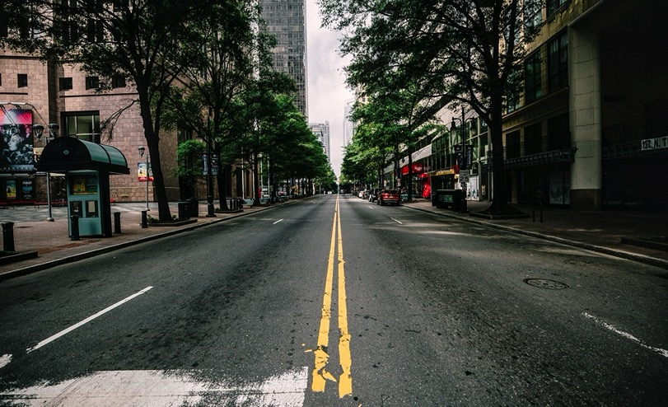
How did we describe this setting?
How did we create suspense?

Slide 3
Imagine a character in the setting now.
What might the character be doing?
Why?
They could be walking down the street, shivering because it’s cold, shielding themselves from the rain, squinting because it’s dark etc.
*The focus today is not on who the character is, or what they look like, but their reactions to the setting/situation.*

Slide 4
What if the character thought they were being followed?
What would their reactions be?
Think back to your bubble map from last Monday’s lesson – how did you feel when we were hiding from Mrs Kelley? What did your body do?
The character may walk faster, glance over their shoulder, their heart might beat faster, they may shake in fear etc.

Slide 5
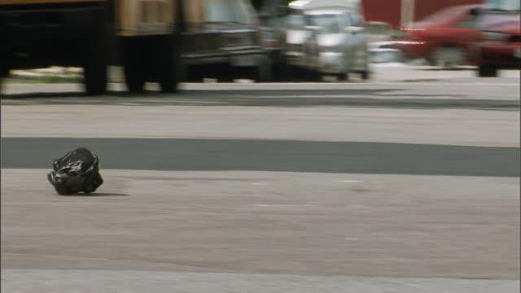
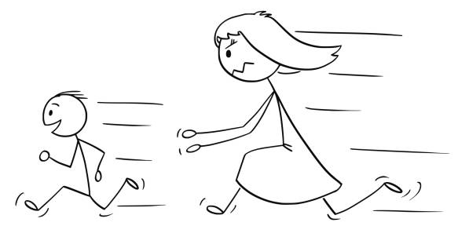
Remember, this is a suspense story, so nothing actually happens!
The character is probably not being followed; it may be a plastic bag blowing in the wind, trees casting shadows, their mum chasing them because they forgot something, their friend rushing to catch up with them etc.

Slide 6

We are going to write a descriptive paragraph about your character’s reactions today.
Red Pen: improve your vocabulary choices to ensure you create powerful imagery.

Slide 7

In your writing today, I am looking for:
- expanded noun phrases (carefully chosen)
- adverbs
- conjunctions (co-ordinating and subordinating)

Slide 8
Write a paragraph to describe your character’s reactions.
Sentence 1 – they walk faster; why?
Sentence 2 – their heart beat
Sentence 3 – they can hear their own movements; footsteps, rustle of their coat/clothes, their breathing
Sentence 4 – they begin to sweat
Sentence 5 – they look around the setting; why?
Sentence 6 – an action they do to make themselves feel safer; pull their coat around them, clench their firsts, walk towards light/a crowd of people, grip on to their bag
Sentence 7 – they shiver/tremble
Sentence 8 – they have butterflies

Slide 9
Tuesday 30th March 2021
LO: to write with purpose
to use imaginative description
C: Suspense Stories

Slide 10
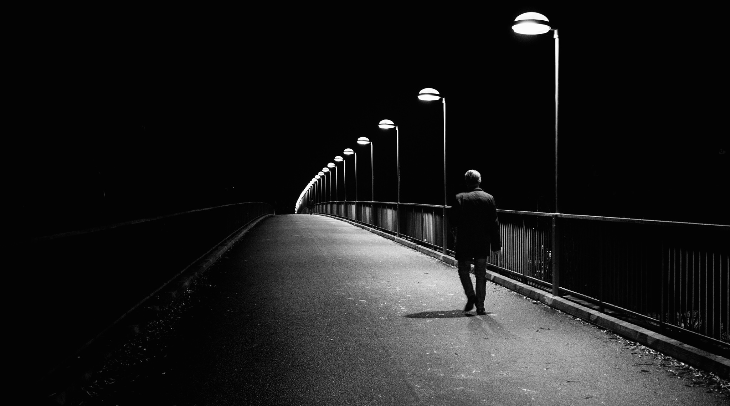
We are going to be writing our own suspense stories this week!
We are going to imagine our character is walking somewhere, and they start to think someone is following them!
The suspense story will end when the character turns around!

Slide 11

Create a bubble map of your ideas:
Who could the character be?
What could the setting be?
Who or what could the ‘follower’ be?

Slide 12
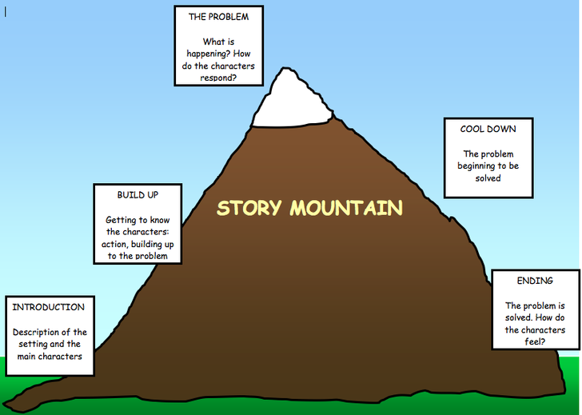
What happens in each part of a story mountain?

Slide 13
Suspense stories are slightly different – they stop at the main event!
We are only going to write the introduction and build up this week.

Slide 14
In your introduction: your character will leave their house, and start walking (down the street, along the path, in the park etc. – wherever you have chosen to set your story).
Describe the setting – what the character can see, hear, what they do etc.
In your build-up; your character will hear a noise/see something out of the corner of their eye, and start to think they are being followed.
Describe what your character can see/hear, and their reactions (e.g. speeding up, heart beating faster etc.)
Your suspense story will end with your character turning around!

Slide 15
Activity
Plan your introduction and build up using the template saved on the website.
Make sure you clearly identify the settings and how it will be ‘suspenseful,’ and the different reactions of your character.
Red Pen: create a bubble map/list of any words/vocabulary that you would like to use in your story. Remember we are trying to create powerful imager and choose our words carefully.

Slide 16
Wednesday 31st March 2021
LO: to write with purpose
to use imaginative description
to use sentences appropriately
C: Suspense Stories

Slide 17
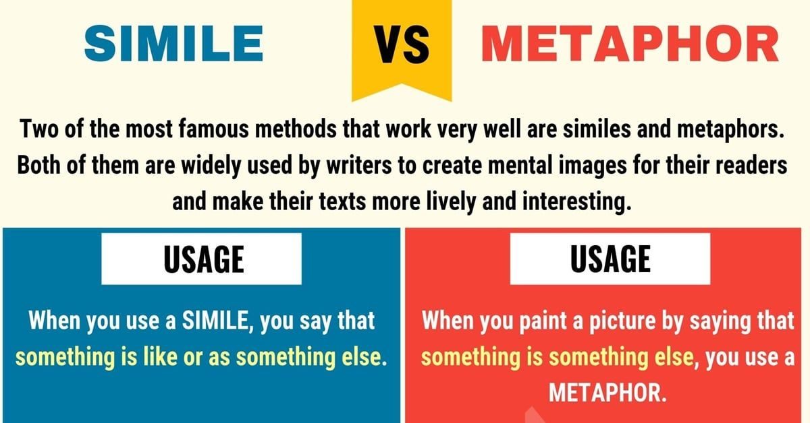
Starter
What is a simile?
What is the difference between a simile and a metaphor?

Slide 18
I am going to give you the start of a simile and you are going to finish it!
The wind howled like…
The noise was as … as …
Her teeth chattered as … as …

Slide 19

We are going to write our ‘introduction’ today!

Slide 20

Example
Jane stepped outside and shivered as the cool, winter air hit her. She was faced with an empty street steeped in pitch black, eerie darkness. As she began her journey down the endless street, the rusting street lights flickered ominously. Dense, black rain clouds obscured the moon, and she squinted to see better in the near darkness. The street was deserted, yet she was surrounded by distant sounds. While the echoes of police sirens screeched, the hum of moving cars buzzed in the next street. The icy leaves rustled behind her, yet the crisp, evening air was still. Towering trees loomed overhead creating dangerous, flitting shadows on the ground.
What features of writing can you identify?
What powerful vocabulary can you find? Why do you think I chose those words?

Slide 21

Remember, I am looking for this in your writing!
detailed descriptions of the surroundings
clues to tease the reader the reader and to keep certain things hidden
short, shocking sentences
subordinate clauses to make the reader wait for an outcome
ellipses
physical reactions from the character
appealing to the reader’s senses
exciting synonyms
similes and metaphors
something is out of the ordinary (not as it seems)
everything happens slowly
detail builds up slowly
you are waiting for something to happen
small things become big
focusing on small things, e.g. senses, weather, character reactions
nothing actually happens!

Slide 22
You are only going to write the introduction today!
When your character leaves their house and starts walking (down the street, along the path, in the park etc. – wherever you have chosen to set your story!
Describe the setting; what the character can see, hear, what they do etc.

Slide 23
Where is your story set?
Who is your character?
What are they going to be doing?
What can they see/hear?

Slide 24
In your writing today, I am looking for:
- a range of conjunctions
- expanded noun phrases (powerful vocabulary)
- similes
- adverbs

Slide 25
Activity
Write your suspense story introduction.
You are going to write for 15 minutes, then stop and edit what you have written.
Have you included everything you need to for your introduction?
Have you included everything I am looking for in your writing?
Red pen edit and improve your work so far!
Then go back to pencil, and continue writing your introduction.

Slide 26
Thursday 1st April 2020
LO: to write with purpose
to use imaginative description
C: Suspense Stories

Slide 27

Starter
You have 5-10 minutes to look back at your work from last lesson.
What do you need to do to improve your work today?
Red pen edit your work using the marking feedback to help!

Slide 28
You are going to write the ‘build up’ today!

Slide 29
Example
It was then that she heard it… It was the unmistakeable sound of a footstep behind her. Was someone following her? The empty street stretched in front of her, as she quickened her pace. Her heart raced and the drum of her blood pumping filled her ears. Every step she took sounded like a clap of thunder. Thud. Thud. Thud. Jane’s eyes darted nervously around, as the dark shadows danced around her. Silence fell. She held her breath and turned around…
What features of writing can you identify?
What powerful vocabulary can you find? Why do you think I chose those words?

Slide 30
You are only going to write the build up today!
When your character hears a noise/sees something out of the corner of their eye and starts to think they are being followed.
Describe what your character can see/hear, and their reactions (e.g. speeding up, heart beating faster etc.)

Slide 31
What can your character see/hear?
What are your character’s reactions?
How are you going to ‘show’ this in your writing?

Slide 32

Remember that your build up should end with your character turning around…
It would be great to end your suspense story on a cliff hanger – leaving the reader to wonder what happens next!
Ending the story with ‘it was only a plastic bag blowing in the wind,’ could spoil the suspense story and ruin all of the suspense that you have worked so hard to build up!

Slide 33
Remember, I am looking for this in your writing!
detailed descriptions of the surroundings
clues to tease the reader the reader and to keep certain things hidden
short, shocking sentences
subordinate clauses to make the reader wait for an outcome
ellipses
physical reactions from the character
appealing to the reader’s senses
exciting synonyms
similes and metaphors
something is out of the ordinary (not as it seems)
everything happens slowly
detail builds up slowly
you are waiting for something to happen
small things become big
focusing on small things, e.g. senses, weather, character reactions
nothing actually happens!

Slide 34
In your writing today, I am looking for:
- a range of conjunctions
- expanded noun phrases (powerful vocabulary)
- similes
- adverbs

Slide 35
Activity
Write your suspense story build up.
You are going to write for 15 minutes, then stop and edit what you have written.
Have you included everything you need to for your introduction?
Have you included everything I am looking for in your writing?
Red pen edit and improve your work so far!
Then go back to pencil, and continue writing your introduction.

Slide 36
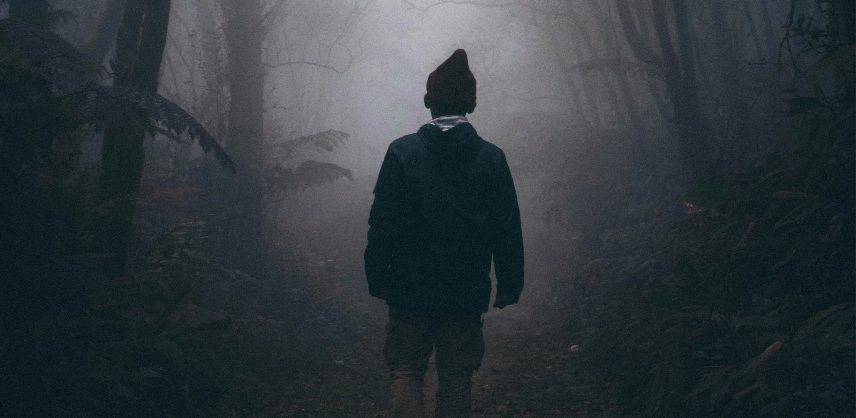
Final Sentence!
Choice A – you could tell the reader what it was all along, e.g.
It was then she realised it was only a carrier bag.
She gasped, as she discovered the noise was only her brother playing a trick!
Choice B – you could leave the reader guessing!
You can know as the author, but keep it a secret! E.g.
It was then that she saw it.
There it was.
She was right. It was coming nearer.

