Slide 1
Friday 28th May 2021
LO: to understand electrical circuits
C: Electricity

Slide 2
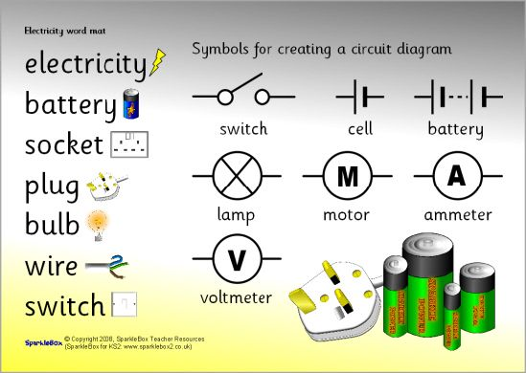
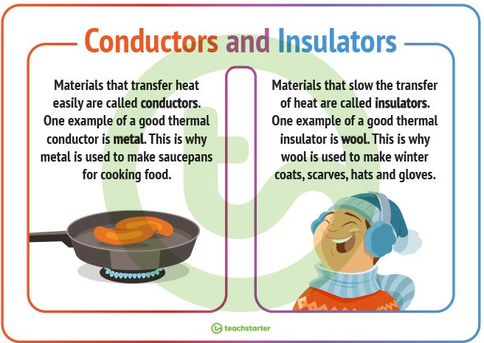
What have you learned so far about electricity?

Slide 3
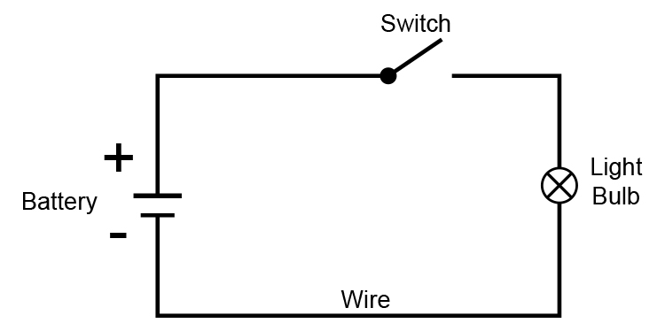
Use: https://phet.colorado.edu/sims/html/circuit-construction-kit-dc/latest/circuit-construction-kit-dc_en.html (click lab).
Make a working circuit that includes a buzzer and a switch.
Once you have finished it, draw a labelled diagram of the circuit.
Think carefully about how you should draw a scientific diagram of an electrical circuit.

Slide 4

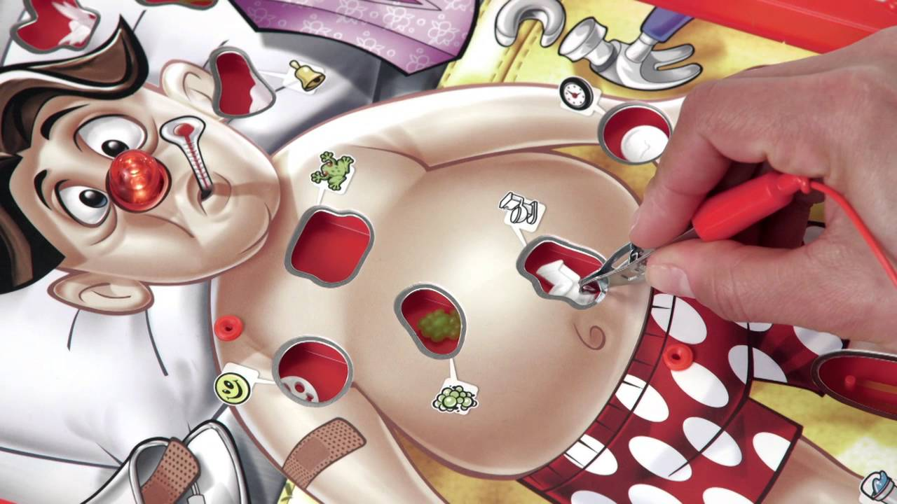
Watch: https://www.bbc.co.uk/bitesize/clips/zxrb4wx

Slide 5
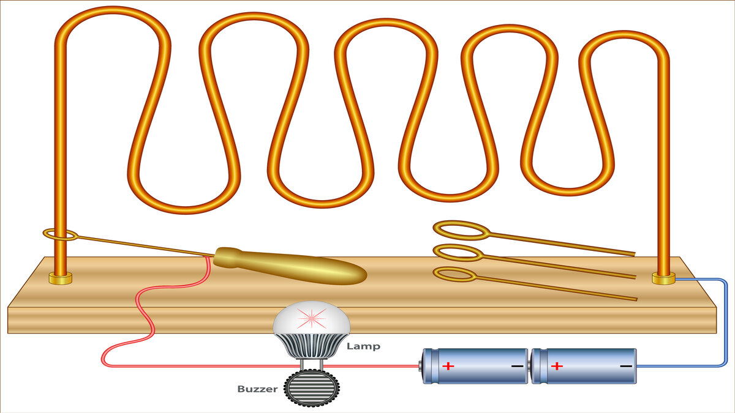
Have a look at this buzz-wire game.
What needs to be included to make the buzzer sound?
What material would be needed for the ‘zig-zag’?

Slide 6
The material you use for the ‘zig-zag’ will need to conduct electricity!
It will also need to be able to move into new shapes.
The only break in the circuit can be between the wire and the loop.

Slide 7
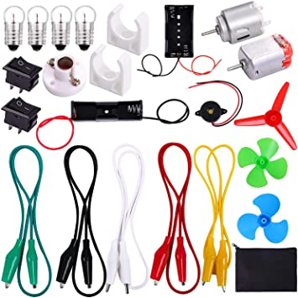
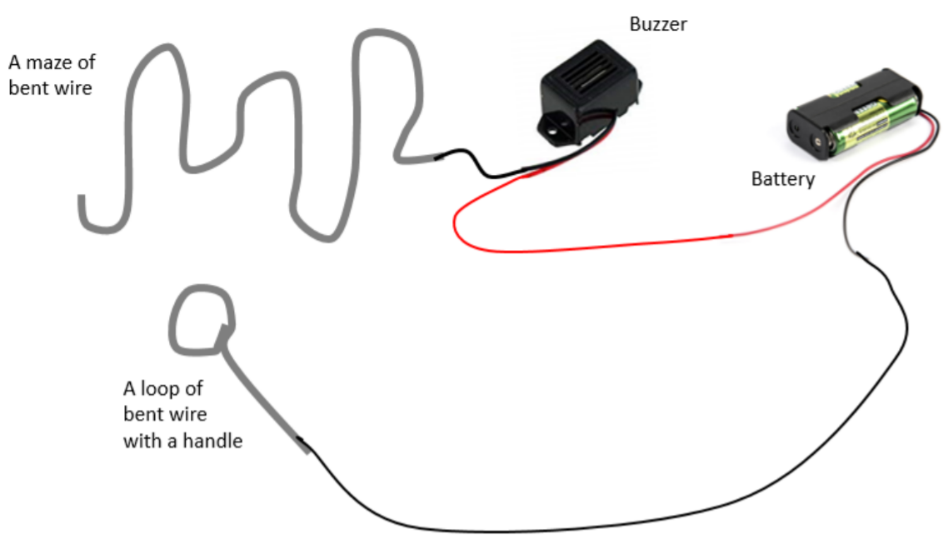
You are going to design a buzz-wire game today!
Have a look at the resources in the image.
Think about how you might make your game.

Slide 8
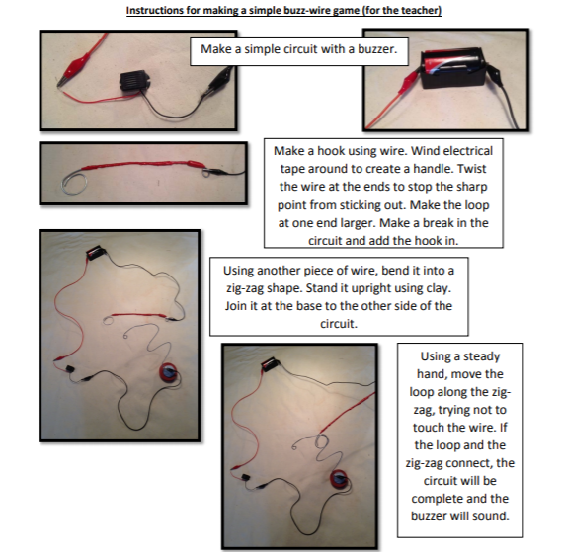

Slide 9

Before you begin:
Some safety ideas to consider:
Although the power from the battery will not be strong enough to shock us, it would be a good idea to create some sort of handle for the ‘loop.’
We can use electrical tape as it is an electrical insulator!
Fold the ends of the loop and zig-sag to make the sharp point at the end of the wire safe.

Slide 10
Activity:
Design, draw and label your buzz-wire game.

Slide 11
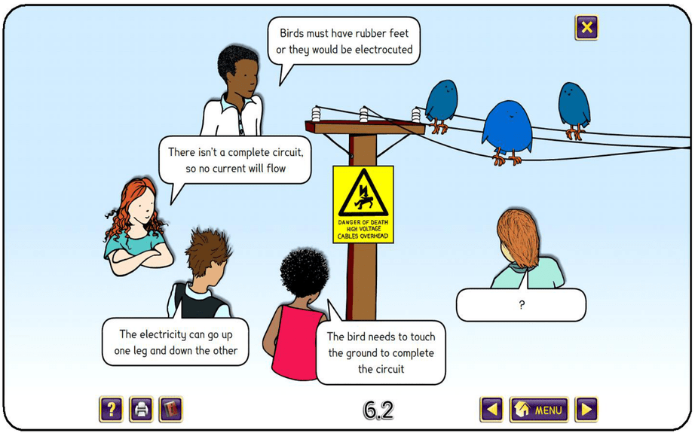
Red Pen:
Why can the birds stand on the electrical wire without being electrocuted or harmed?

