Slide 1
Tuesday 25th May 2021
LO: to showcase your writing skills from this year.
C: Mayans.

Slide 2
This week…
We know how much you have all enjoyed learning more about the Mayans and finding out lots of information about their civilisation.
This week in English you are going to have an opportunity to further your knowledge and showcase your incredible writing skills!
We are setting you a writing challenge to complete over the next 3 days! Here are the writing options you can choose from:

Slide 3
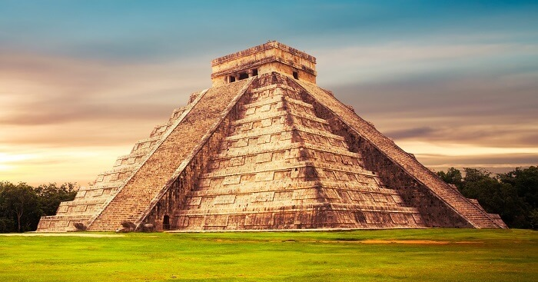

Write a diary entry from the point of view of an archaeologist who has just discovered an ancient Mayan Pyramid.
What features should I include in a diary entry?
https://www.bbc.co.uk/news/blogs-trending-36259047

Slide 4
Dear Diary,
Today was a beautiful, bright and sunny day so I decided to build a boat! I needed to get some long, hard wood so I travelled to the forest to collect a huge pile. After I had gathered some wood, I began to nail the pieces together using my flint hammer and dinosaur teeth for nails. It took 2 hours to build, but once it was finished I was very proud of myself. Was it going to float?
After some time, I began to get hungry so I decided to go fishing on my brand new log boat. Heaving the boat, I pushed it down towards the lake and into the water. Fortunately, the boat floated and so I jumped in! Slowly, I rowed out into the middle of the lake and then threw my fishing rod (made from a stick) into the deep, fresh water. Suddenly, my rod pulled me forward so I began to lift the fish into the boat. It was really tricky to catch the fish because it was so wriggly and heavy! Eventually, I caught the fish and sailed back to land. The fish was golden and very slippery!

Slide 5
In the afternoon, I decided to have a nap because I was so tired from fishing! At that moment, a huge brow bear came charging through the woods like thunder. Some hunters from my tribe ran away but I stood my ground and began to throw spears at the growling, snarling bear! How was I going to get away! The spears didn’t work so I grabbed my hand made bow and arrow and started shooting at it. Whimpering, the bear tumbled to the ground. YES! We had defeated it!
As the sun set in the sky, my belly began to grumble. What was I going to eat? I skipped back to my family’s hut and asked my Mum for something to eat whilst my baby sister lay on her fur skin mat. She was cooking some raw, mammoth meat on the fire and it smelt delicious. We were running out of wood so I went outside to look for some. Fortunately, I had some left over from my boat! Once the mammoth was cooked, I began to eat it. Unfortunately, it tasted disgusting, however it filled me up!
I wonder what will happen tomorrow…

Slide 6
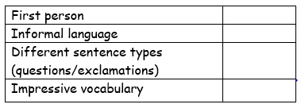
Success Criteria

Slide 7
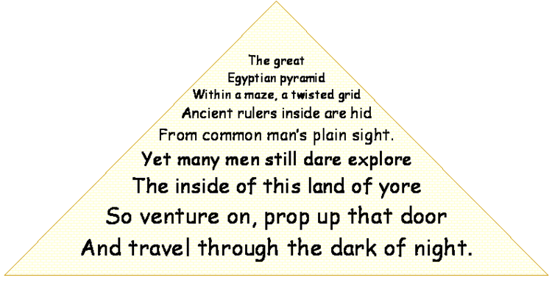
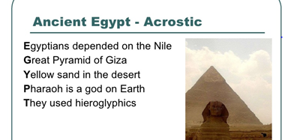
2) A sacrifice to the gods.
Create a poem- this could be a shape poem, acrostic poem or a rhyming poem.
Shape poem
Cocoa pods ripe…
Bitter made sweet.
Packaged as treasures
For you, and for me.
Please gods hear my plea,
A good harvest is what we need.
Rhyming poem
Acrostic poem

Slide 8
What ideas can you think of that relate to the Mayans?

Slide 9
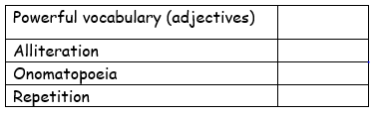
Success Criteria

Slide 10

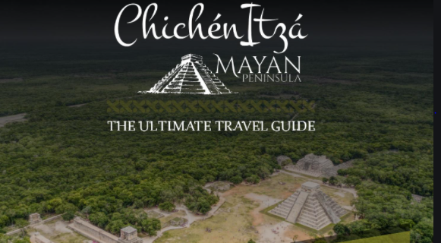
3) A Chichen Itza visitors guide
What information would tourists need to know?

Slide 11
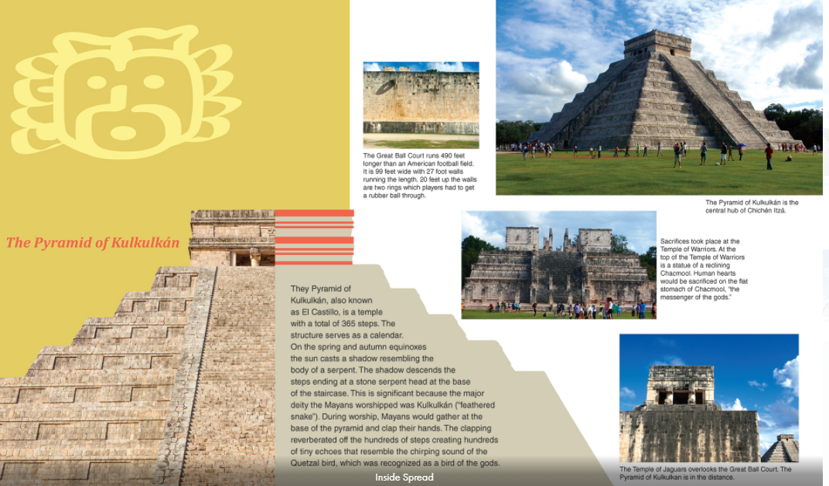

Slide 12
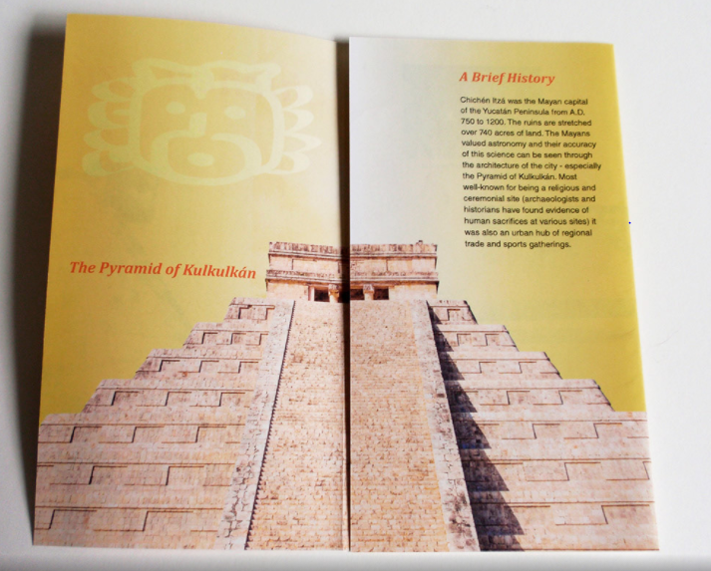

Slide 13
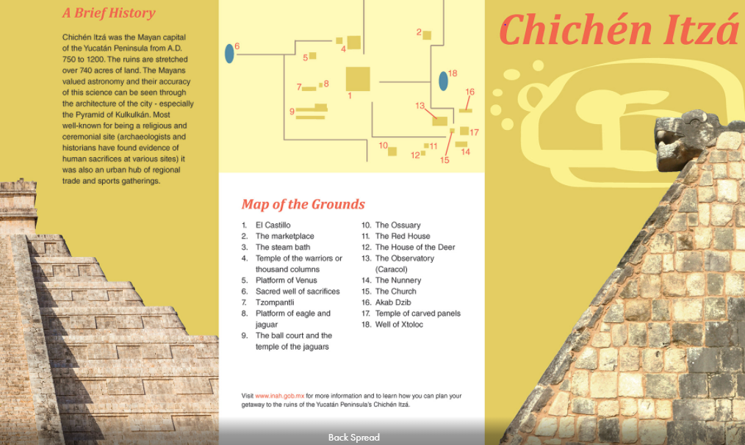

Slide 14
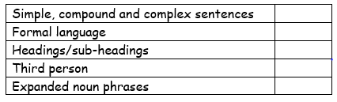
Success Criteria

Slide 15
4) Non-chronological information leaflet.
What are the features of non-chronological reports?
Create a non-chronological report providing the reader with information about the Mayans.
What sub-heading could we include?
Meeting the Maya
Gods and religion
Food
Where did the Maya live?
The number system

Slide 16
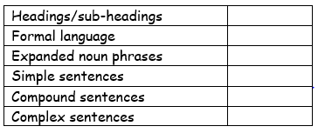
Success Criteria

Slide 17
5) Create a Mayan recipe for a cookbook.
What style of writing would you use for a recipe?
What are the features of instructions?
https://www.youtube.com/watch?v=Zay4WRJKc0k

Slide 18
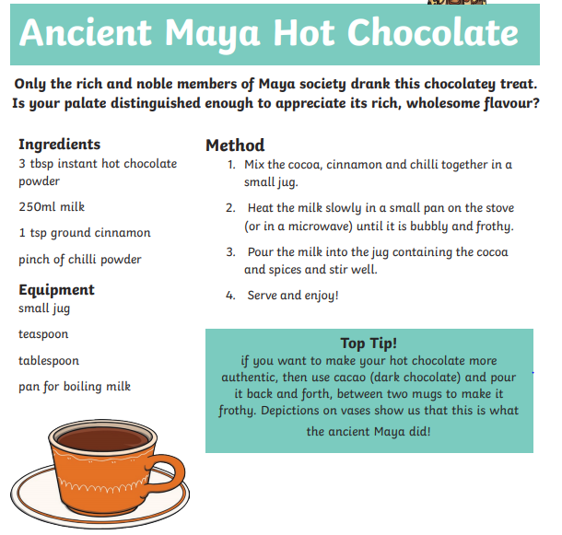
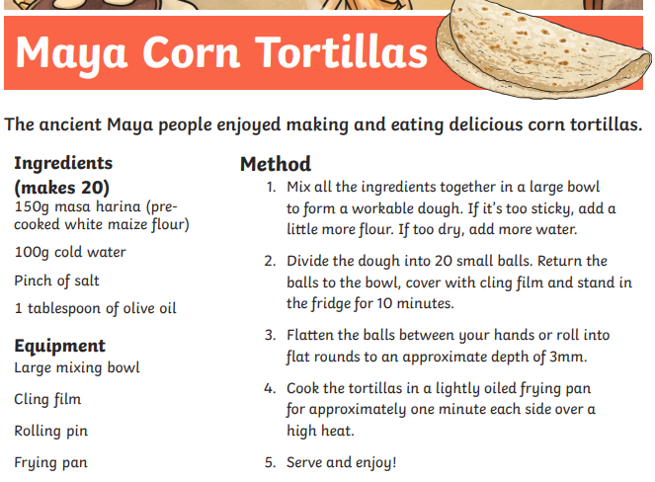

Slide 19
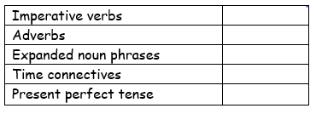
Success Criteria

Slide 20
Activities
Write a diary entry from the point of view of an archaeologist who has just discovered an ancient Mayan Pyramid.
A sacrifice to the gods.
Create a poem- this could be a shape poem, acrostic poem or a rhyming poem.
A visit to Chichen Itza visitors guide
Non-chronological information leaflet.
Create a Mayan recipe for a cookbook.

