Slide 1
Wednesday 6th May
LO: To understand electrical circuits.
C: Electricity.

Slide 2

Electrical safety
Why do we need to be careful when handling electrics?
Http://www.switchedonkids.org.uk/electrical-safety-in-your-home
Visit every room in the virtual house and note down all the dangers that you discover (some are repeated in different rooms).
Which dangers did you see?
Did any of the dangers surprise you?

Slide 3

Binfield needs your help!
Today you will be making electrical safety posters for the school, warning other children of some of the dangers associated with electricity.
Your posters will focus on one of the dangers you saw on the virtual house.
Where might the posters be displayed?
On the door to the toilets
Near a plug socket
In the corridor

Slide 4
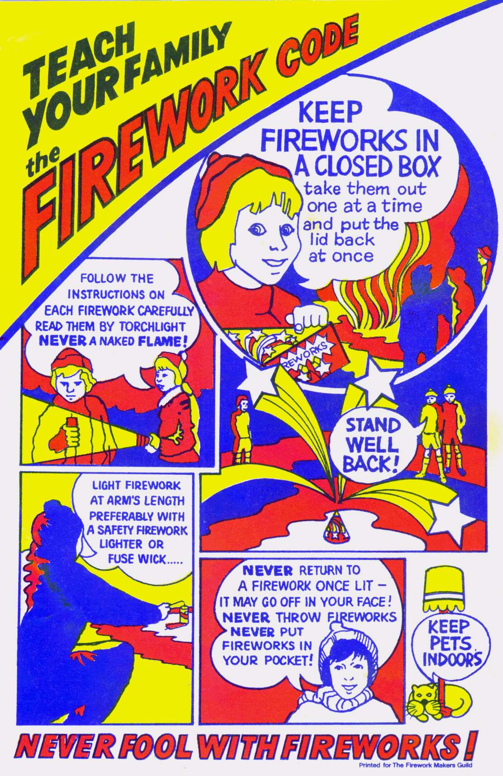
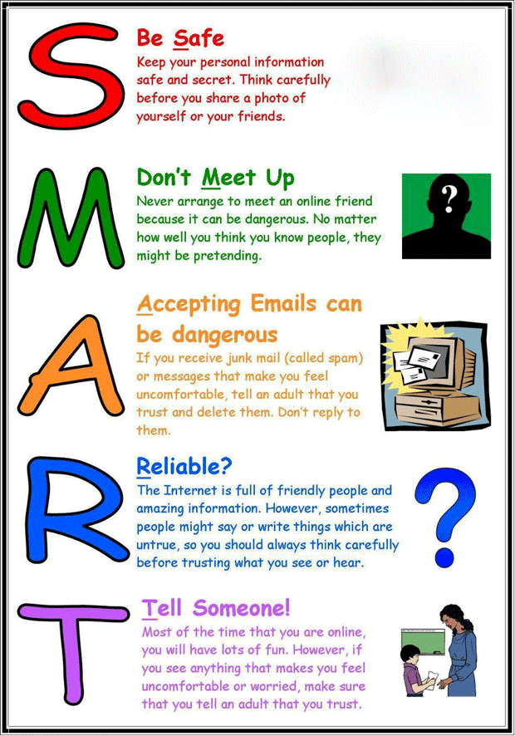
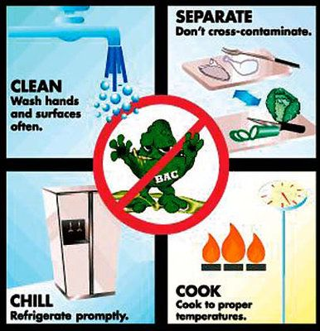
EXAMPLES…

Slide 5

The danger: overloading plug sockets.
What do you need to think about?
What will grab attention?
How many words will be on the poster?
What words or phrases could be used?
What colours should you use?

Slide 6
Over to you…
Design and make an electrical safety poster.
You should choose one safety issue to focus on:
not using anything with broken wires
never put anything in sockets
don’t leave wires trailing across the floor
don’t touch electrical things with wet hands
Make a rough draft first.
Choose where the words will go, what they will say, where the picture will go, what colours they will choose.
Red Pen: Why it is important to use electricity safely?

