Slide 1


18.1.2021
L.O: Multiplication and Division
C: 5 times table.

Slide 3


1) How many apples?
2) How many fish?
3) Complete the number track.
5 | 10 | 15 |  |  | 30 |  | 40 |  |  |  | 60

Slide 4
1) How many apples?
2) How many fish?
3) Complete the number track.
25
10
5 | 10 | 15 |  |  | 30 |  | 40 |  |  |  | 60
20
25
35
45
50
55

Slide 6






Jack has built some towers using cubes.
How many towers has he built?
4
5
How many cubes are in each tower?
How many cubes has he used in total?
20
4
$$×$$
5
$$=$$
20
or
5
$$×$$
4
$$=$$
20

Slide 7







Whitney has also been building towers using cubes.
Have a think
3
How many towers has she built?
5
How many cubes are in each tower?
15
How many cubes has she used in total?
3
$$×$$
5
$$=$$
15
or
5
$$×$$
3
$$=$$
15

Slide 8





Dexter has also been building towers using
cubes.
Have a think
5
How many towers has he built?
7
How many cubes are in each tower?
35
How many cubes has he used in total?
5
$$×$$
7
$$=$$
35
or
7
$$×$$
5
$$=$$
35

Slide 9

2 $×$ 5 $=$
10

Slide 10

6 $×$ 5 $=$
30

Slide 11

5 $×$ 11 $=$
55

Slide 12
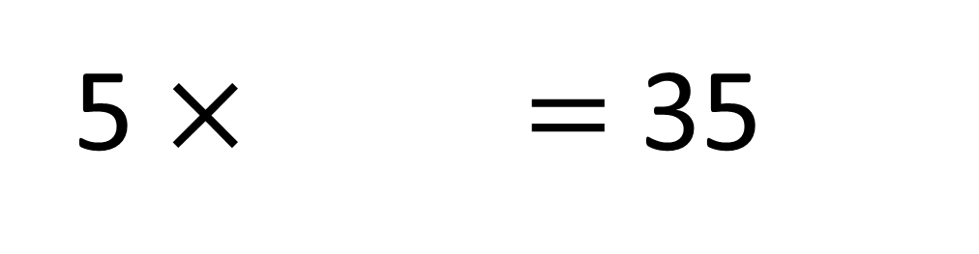
5 $×$ $=$ 35
7

Slide 13

9
$×$ 5 $=$ 45

Slide 14




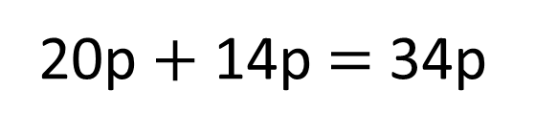
Amir and Alex have some money.
Have a think
Here is Amir’s money.
4 $×$ 5p $=$ 20p
Here is Alex’s money.
7 $×$ 2p $=$ 14p
How much money do they have altogether?
20p $+$ 14p $=$ 34p
Altogether they have 34p

Slide 15



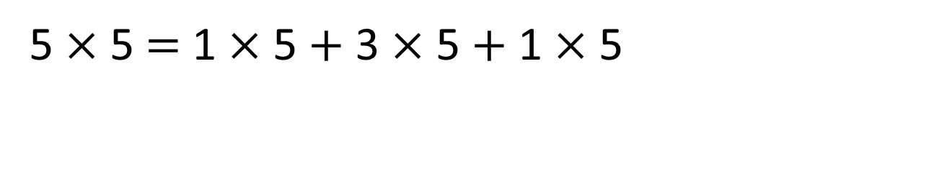
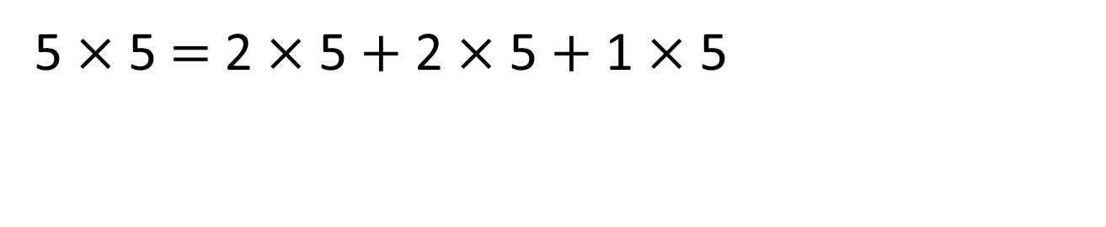
5 $×$ 5 is the same as 1 $×$ 5 $+$ 4 $×$ 5
5 $×$ 5 $=$ 2 $×$ 5 $+$ 3 $×$ 5
5 $×$ 5 $=$ 2 $×$ 5 $+$ 2 $×$ 5 $+$ 1 $×$ 5
5 $×$ 5 $=$ 1 $×$ 5 $+$ 3 $×$ 5 $+$ 1 $×$ 5
Have a think

Slide 16







Use $<$, $>$ or $=$ to complete the comparisons
$$=$$
3 $×$ 5 5 $×$ 3
$$=$$
5 $×$ 5 $+$ 5 $×$ 5 5 $×$ 10
$$>$$
9 $×$ 5 10 $×$ 5 $−$ 2 $×$ 5
Have a think

