Slide 1
LO: to understand beliefs
C: to reflect

Slide 2

What do Buddhists believe about change?

Slide 3
While Buddhists believe that everything changes and people don’t want it to, the Buddha also teaches that people need to accept that everything changes – it is a natural part of life and should be embraced rather than feared.
What do you think about this?

Slide 4
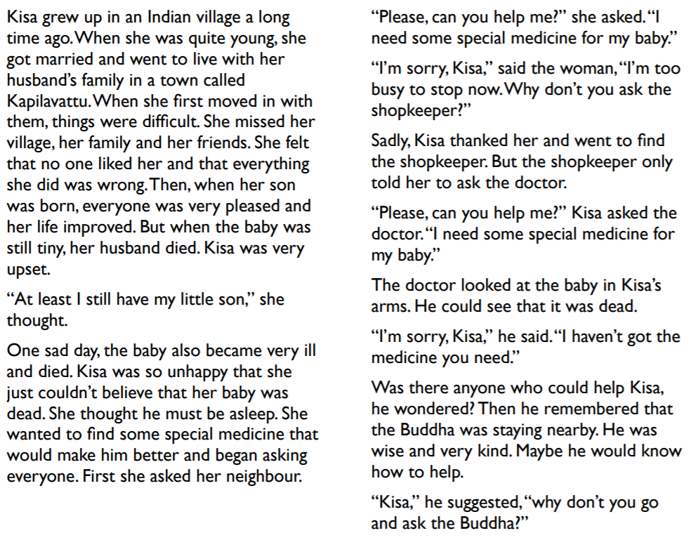
Kisa and the Mustard Seed

Slide 5
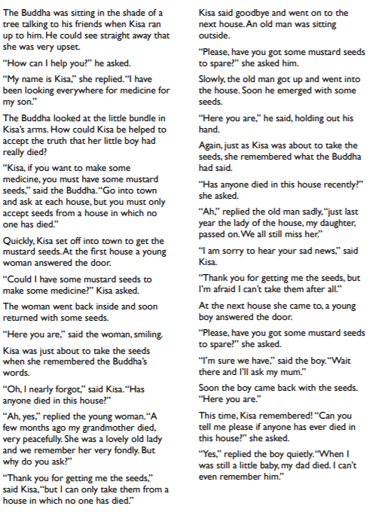
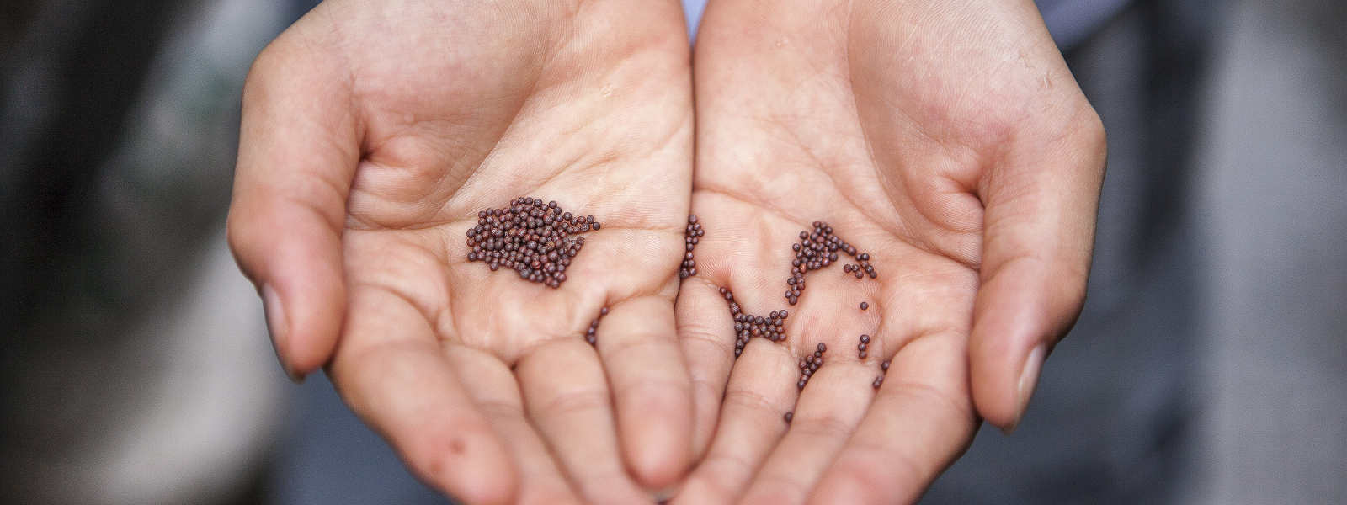

Slide 6

Why can’t Kisagotami understand that her son is dead?
Why did the Buddha tell Kisa to get mustard seeds?
Would mustard seeds have helped fix her problem?
Why doesn’t the Buddha just tell Kisagotami that everyone dies, rather than sending her off on the impossible mission?
What does Kisagotami learn as she goes house to house seeking a mustard seed?
What effect does Kisagotami’s lesson have on her?
What does she achieve as a result?
What can we take away from this story?

Slide 7
Little Losses
E.g. friends moving away, changing teachers, changing schools etc.
Have you ever experienced any of these?
How did it make you feel?
How did you make peace with the change? (How did you get used to it?)
How did you make yourself feel better?
How did other people help?

Slide 8
Activity:
Create a story board for the story of Kisa and the Mustard Seed.
Paddling: order the pictures and write sentences underneath.
Snorkelling and Diving: How does this link to the Buddha’s teaching on change?
Paddling Red Pen: Can you think of a time when you were like Kisa? When something changed, but you didn’t’ want it to or you lost something and it couldn’t be replaced? How did you feel? How did you get used to the change?
Snorkelling and Diving Red Pen: The story of Kisa and the Mustard Seed is a parable. Use a dictionary to define the word ‘parable.’ Can you think of any other religions which have parables? Can you give any examples of parables you may have heard?

