Slide 1
Computing

Slide 2
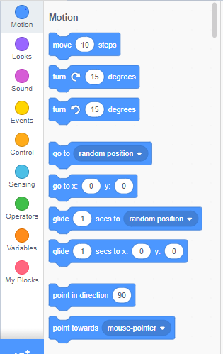
Recap…
What can you remember from our last computing lesson?
What is a continuous loop?
What control did you have to include in your continuous loop?

Slide 3
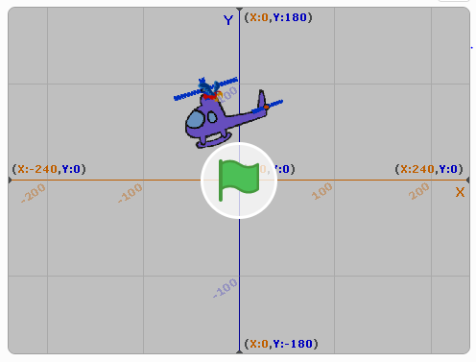
https://scratch.mit.edu/projects/316961043/
Spend the first 15 minutes of the lesson playing with the game.
What does the game do?
What are the controls?
What code do you think is being used?

Slide 4
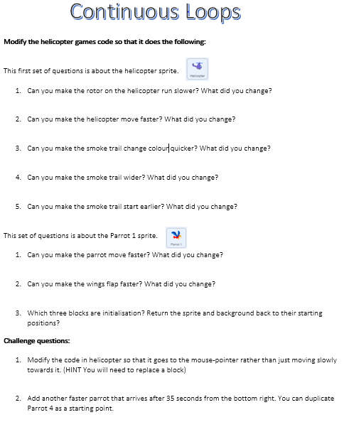
Your activity
You are going to complete the task sheet provided.

