Slide 1
Art
Rainforest inspired art.

Slide 2
Look at the Kew Gardens website page
https://www.kew.org/kew-gardens/attractions/marianne-north-gallery
Watch the embedded video. ‘The remarkable Miss North’ What can we learn from this artist Marianne North? What inspired her? How old was she when she travelled the globe?
Take Notes to create a factfile about Marianne North.

Slide 3
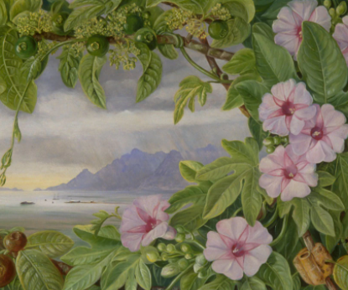
Using your best sketching skills, draw your own version of this piece of Marianne's artwork.

