Slide 1
LO: to identify the different types of teeth in humans and their simple functions.
C: Animals including humans

Slide 2
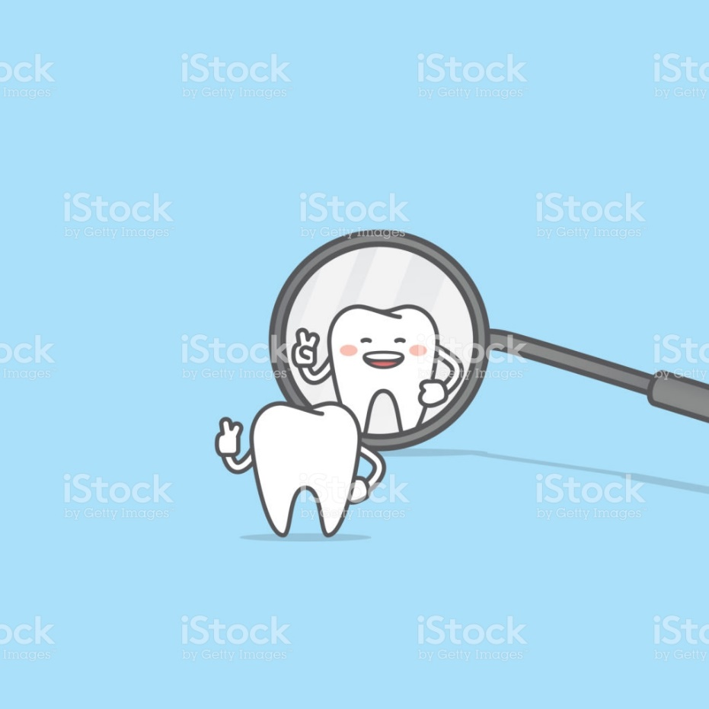
Starter
Use a mirror to have a look at your teeth.
Can you describe your teeth?
What shape are they? Size?

Slide 3
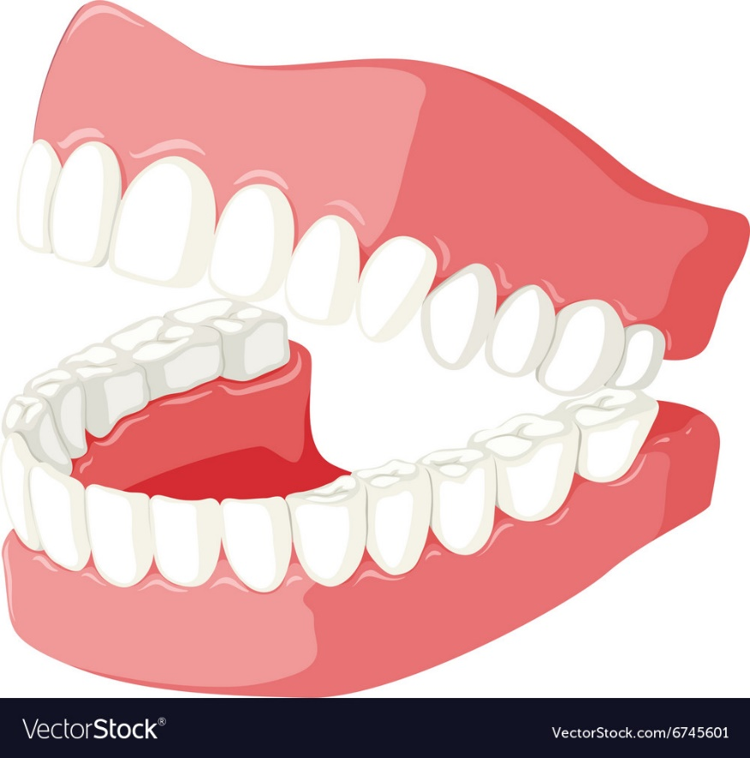
How many teeth have you got?
How many adult teeth do you have?
How many baby teeth do you have?
Why do we lose our baby teeth?

Slide 4
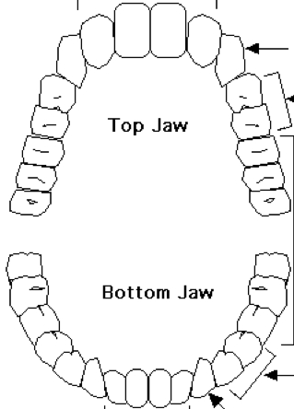
Activity 1
On the mouth outline:
In red – colour in any adult teeth you have
In green – colour in any baby teeth you still have
Put a cross through any teeth that are currently missing
Circle any teeth which you have had dental work on, e.g. fillings or crowns

Slide 5
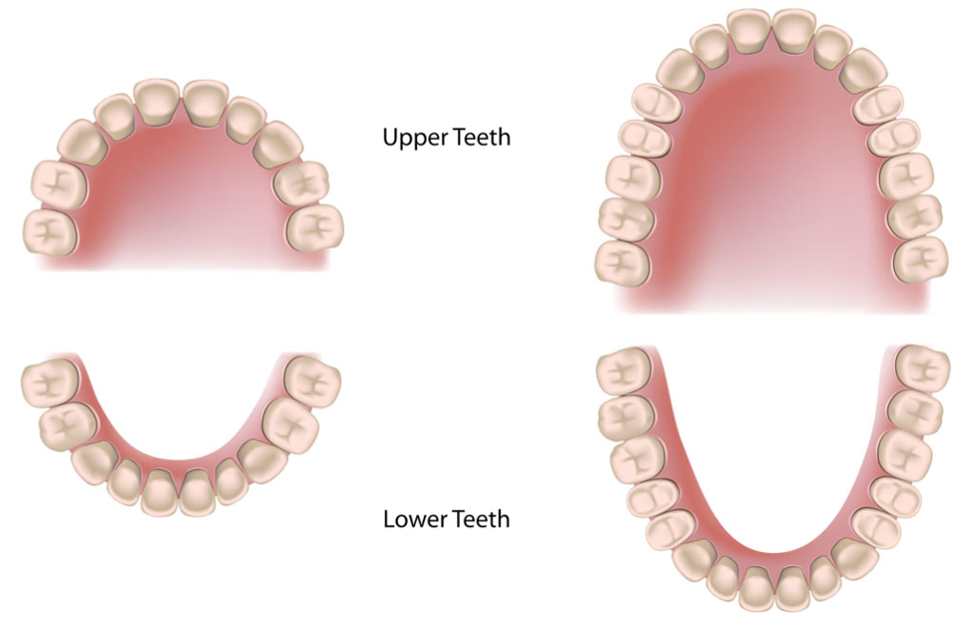
Children have 20 teeth.
8 incisors, 4 canines and 8 molars.
Adults have 32 teeth including wisdom teeth.
Babies’ jaws are too small to hold all those big teeth.

Slide 6
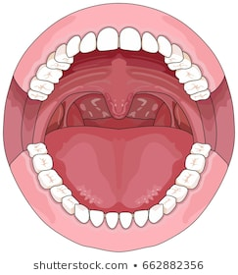
Look at your teeth again.
Are all of your teeth the same shape?
Why aren’t they the same shape?
What do you think each shape is for?

Slide 7
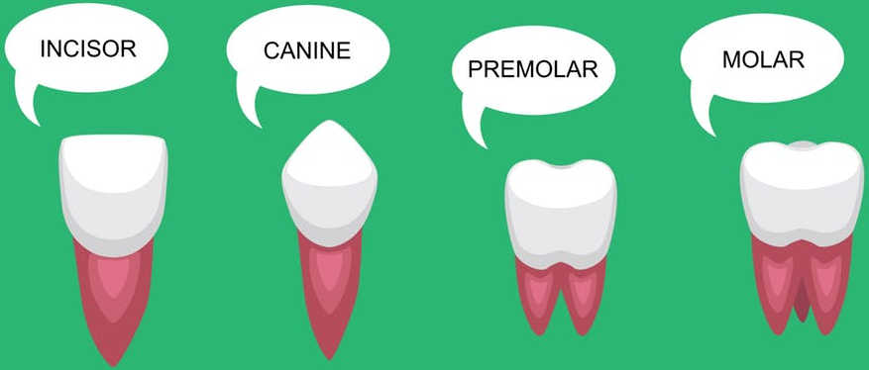
https://www.bbc.co.uk/bitesize/topics/z27kng8/articles/zsp76yc

Slide 8
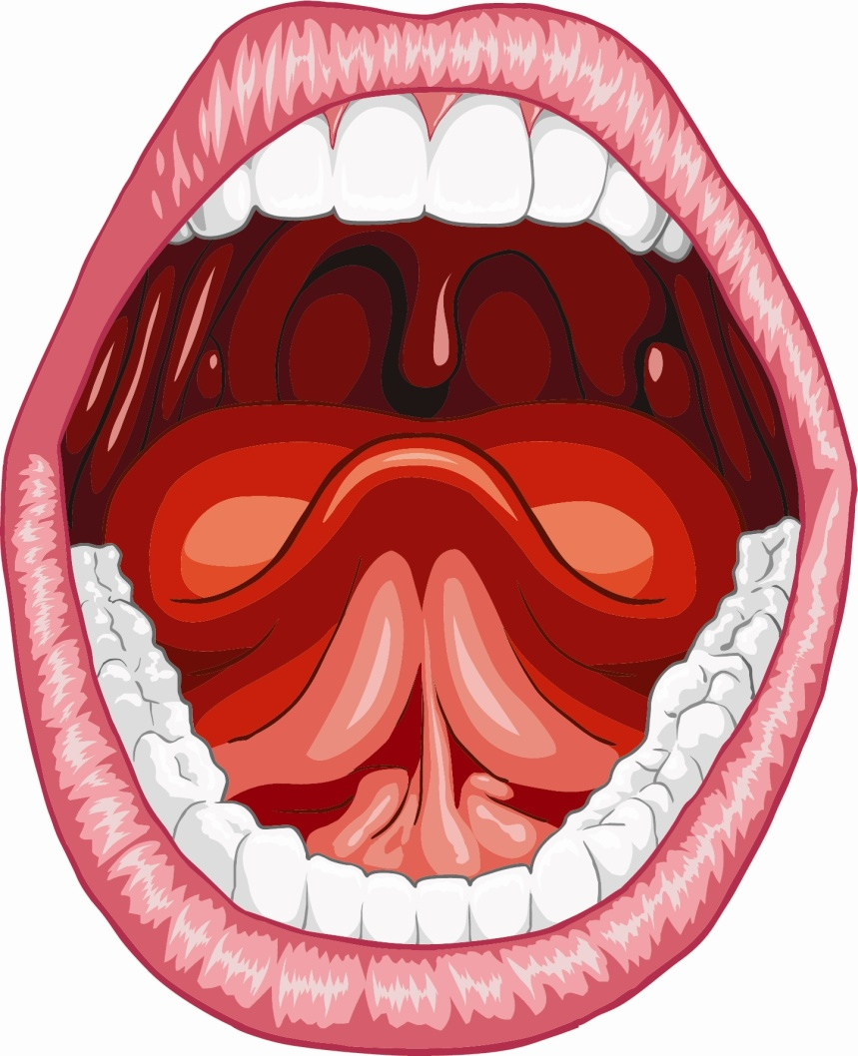
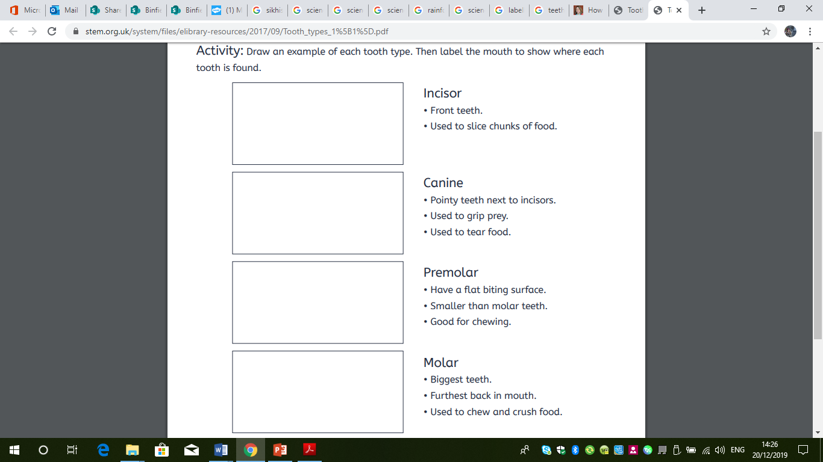
Types of teeth
Incisors
Used for snipping and cutting food
(think about scissors)
Canines
Used for ripping and tearing
Molars
Used for grinding and chewing

Slide 9
Different animals – different teeth!
Carnivores or meat eaters have sharp teeth. This helps them tear the meat.
Herbivores (animal that only eat plants) have flat teeth. These allow them to grind down their food easier.
Omnivores or animals that eat meat and plants (like humans) have sharp teeth at the front and flat teeth at the back.

Slide 10
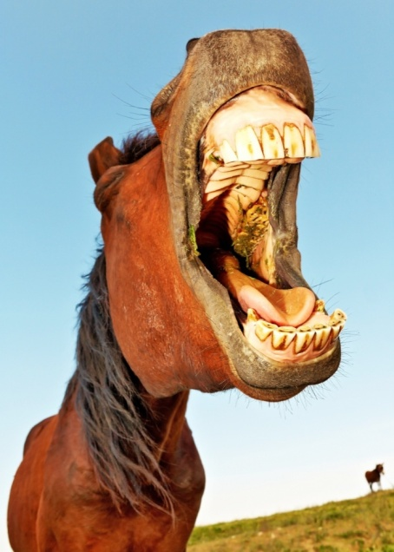
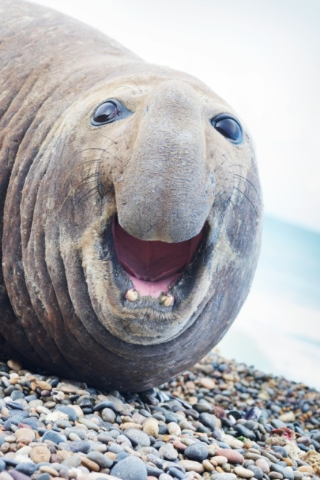
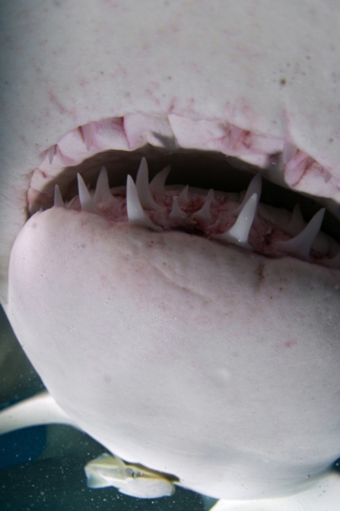
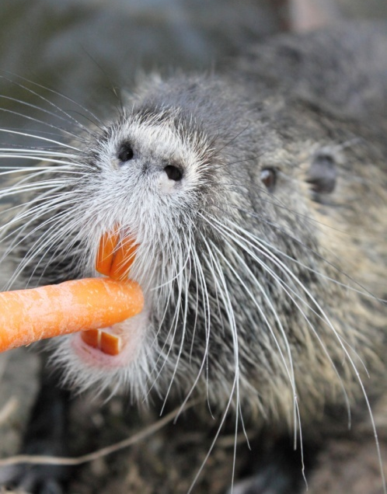
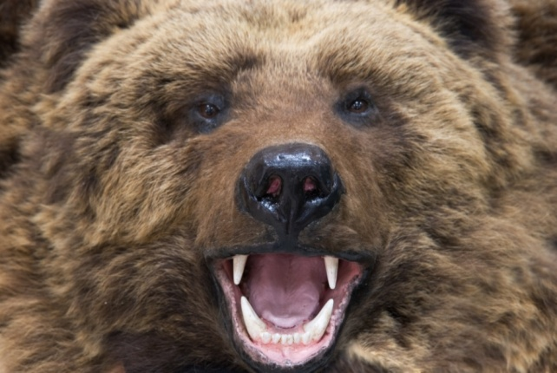
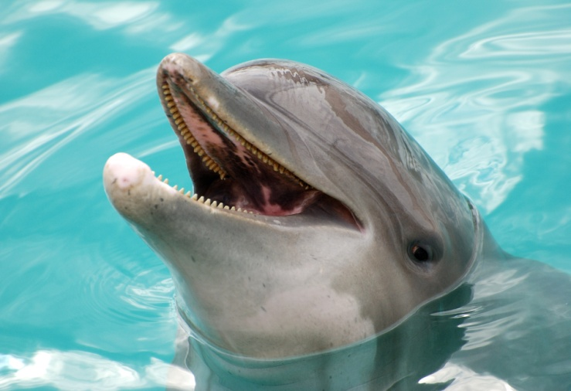
Different animals – different teeth!

Slide 11
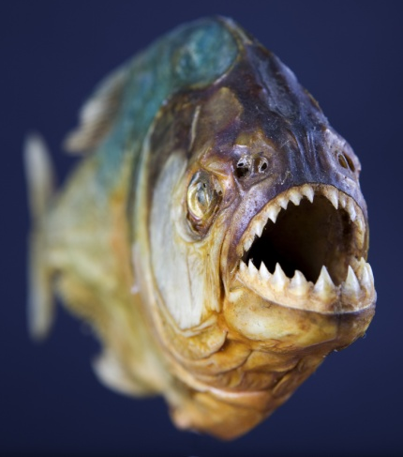
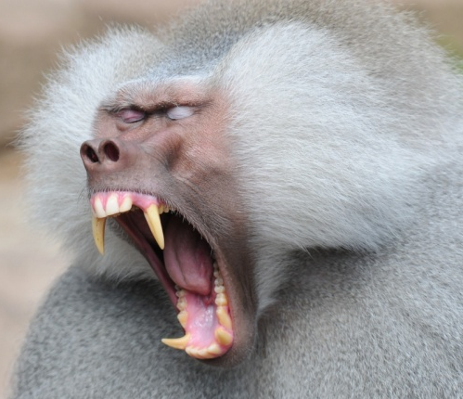
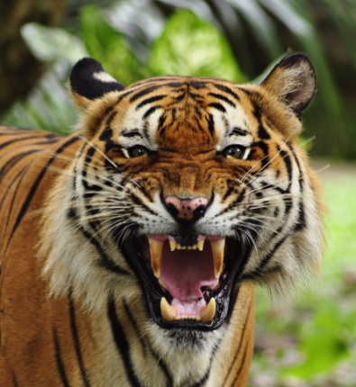
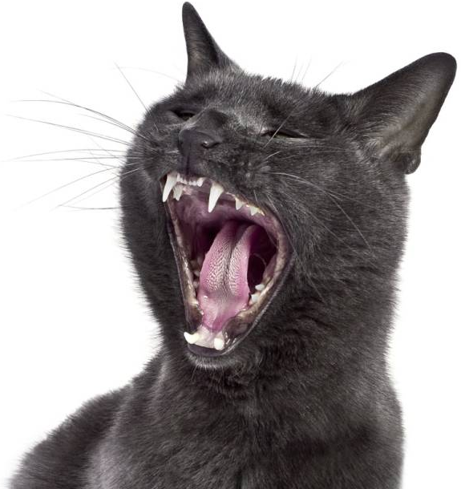
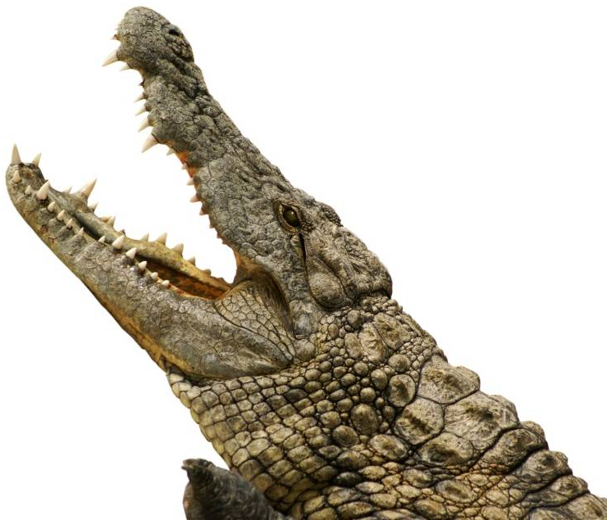
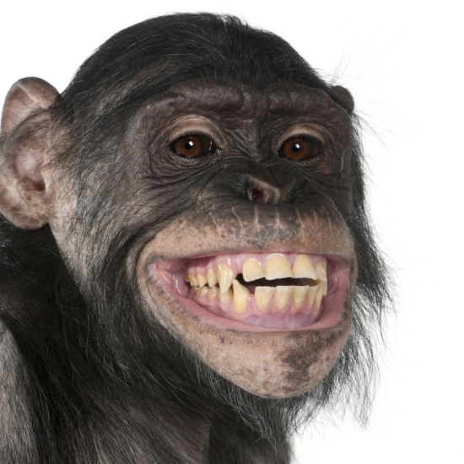

Slide 12
Animal teeth facts
Sharks can have over 20,000 teeth in one lifetime!
Crocodiles have up to 60 teeth in their mouth at one time.
Poisonous snakes have hollow fangs so that they can inject venom.
Giraffes have the same number of teeth as humans – 32!
Crocodiles can have up to 2-3,000 teeth in their lifetime.
Dolphins can have more than 200 teeth in their mouth at any one time!
Rabbits front teeth don’t stop growing.
Dogs have 42 teeth, cats 30 and pigs 44!
Elephants tusks are the largest teeth in the world.

Slide 13

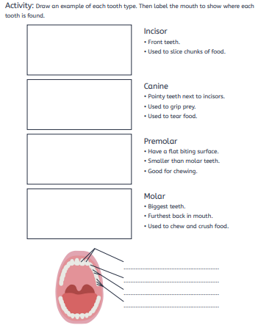
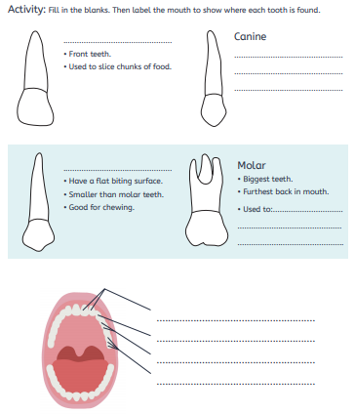
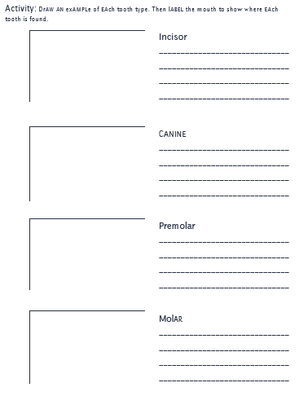
Paddling | Snorkelling | Diving
Draw an example of each tooth type, next to the descriptions. Red Pen: Why do we have teeth? | Name each tooth type and write a description of each type. Red Pen: Why do we have different kinds of teeth? | Draw a picture of each tooth type and write a description of each type Red Pen: Which teeth are sometimes missing in herbivores. Why do you think this? Explain your answer.

