Slide 1
LO: to reflect
C: Buddhism

Slide 2

Starter: Happiness is…
Complete the sentence.

Slide 3

Sometimes, people feel happy when singing a cheerful song.
Listen to this song and look at the lyrics: https://www.youtube.com/watch?v=jv-pYB0Qw9A
How do you feel?
What does this song remind you of?

Slide 4

What makes you happy?
Recall a time when you were really happy. How did that feel?
Who might not feel like singing this song right now?

Slide 5
https://www.youtube.com/watch?v=isSXzbPByks
If someone gave you a million pounds, what would you do?
What do you notice about your ideas?
Could you categorise them into groups?
e.g. ideas that would help others and those that are about buying things or doing things for yourself.
Is one set of ideas better than another?

Slide 6
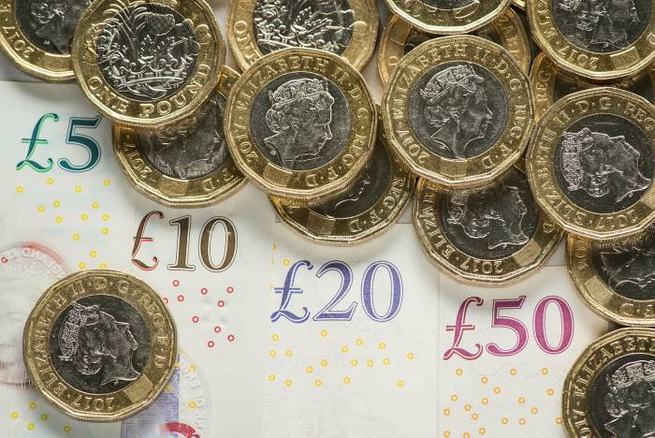
Would you give to charity?
Why/why not?
If someone gave you a million pounds, what would you do?
This time, the majority of the money is to be used to help your family or charity.
How could this make people happy?

Slide 7
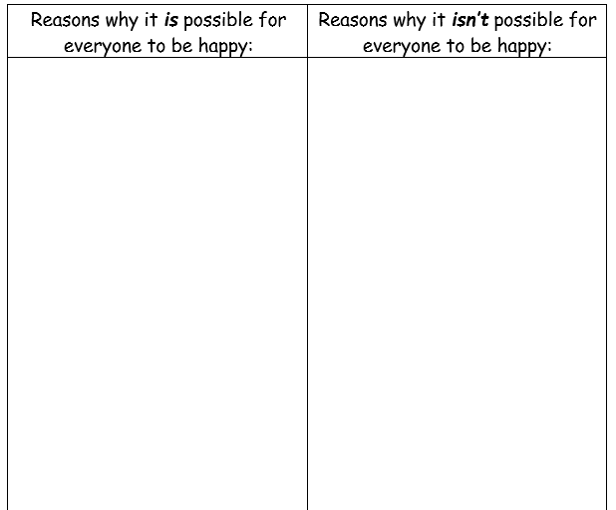
Is it possible for everyone to be happy?
Activity:
Complete the table, giving reasons why you think it is possible for everyone to be happy and why it isn’t possible for everyone to be happy.
What is your final answer to the question?

Slide 8

What about religious believers?
Are they happy?
Do you think they are happier than
non-religious people?
Why/why not?

