Slide 1
Tuesday 5th January 2021
LO: to use imaginative description
C: Rainforest Setting

Slide 2
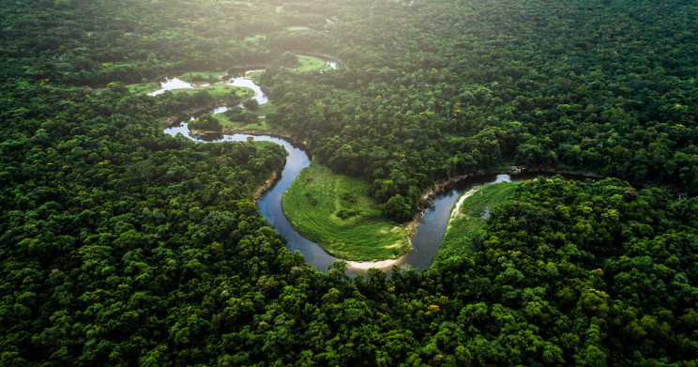
Our new English book for this term is –
The Great Kapok Tree!
The Kapok tree is found in the Amazon rainforest.
What do you already know about rainforests?

Slide 3
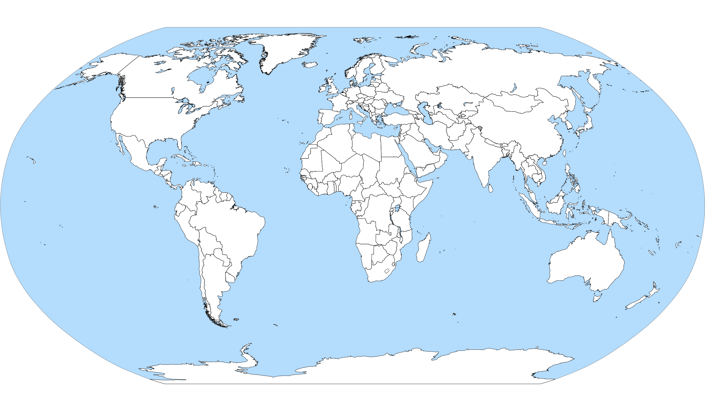
Can you locate the Amazon Rainforest on the map?

Slide 4
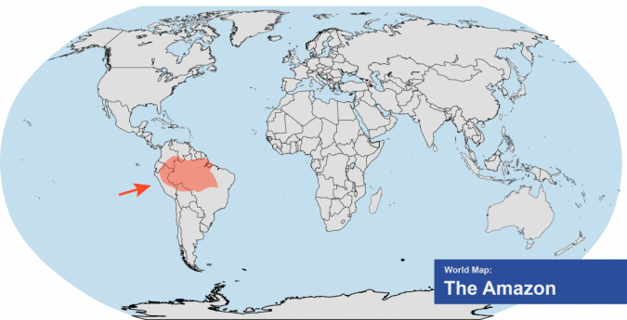

Slide 5
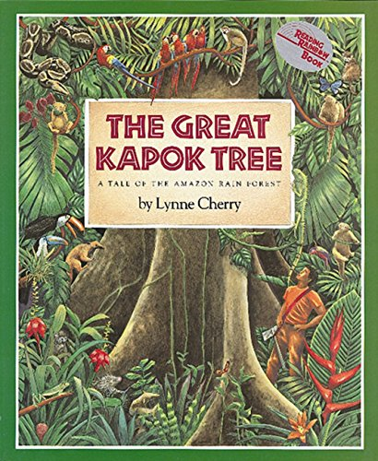
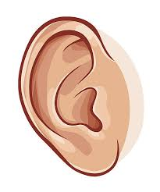
The Great Kapok Tree
https://www.youtube.com/watch?v=gw0arFtHeVw

Slide 6
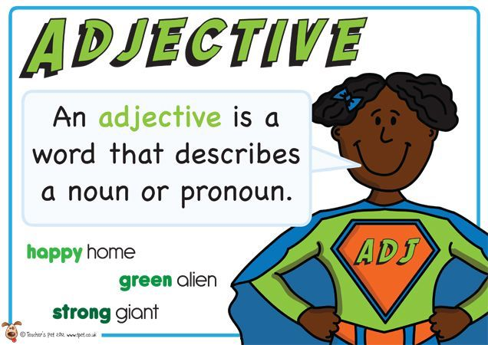
Adjective
What is an adjective?
https://www.youtube.com/watch?v=e-C5FPbS7zc&safe=active#action=share

Slide 7
Which type of work is underlined in the sentence below?
The house was on top of a steep hill.
Verb
Adjective
Adverb
Noun

Slide 8
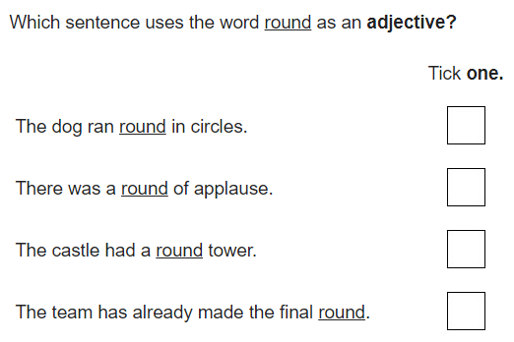

Slide 9
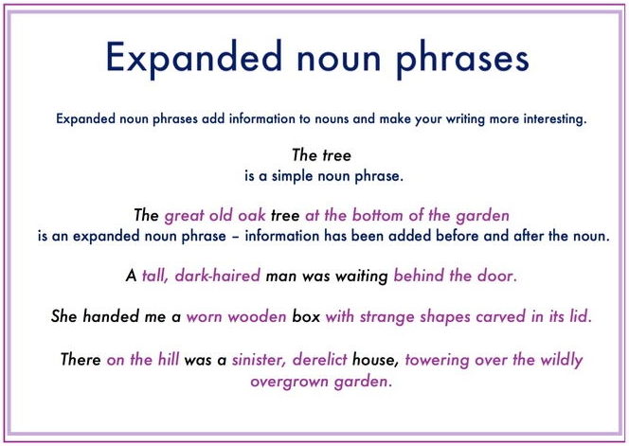
Expanded Noun Phrase
What is an expanded noun phrase?
https://www.youtube.com/watch?v=8GGWLr11Bio&safe=active

Slide 10
Rewrite the underlined noun phrase below as an expanded noun phrases, to give a full description of the creature.
Adam saw a creature.

Slide 11
Examples of expanded noun phrases
The tropical, colourful flower under the branches
An old, dying tree stump beside the murky river
A colossal, sturdy tree near the tangled vines
The dangerous, poisonous bush with prickly leaves
A glassy, smooth river in the distance
A thin, black creature with terrifying red eyes
A miniscule, blue beetle with four eyes on the top of his head
Remember to use a comma between the adjectives you are using.
Why do we need a comma?

Slide 12
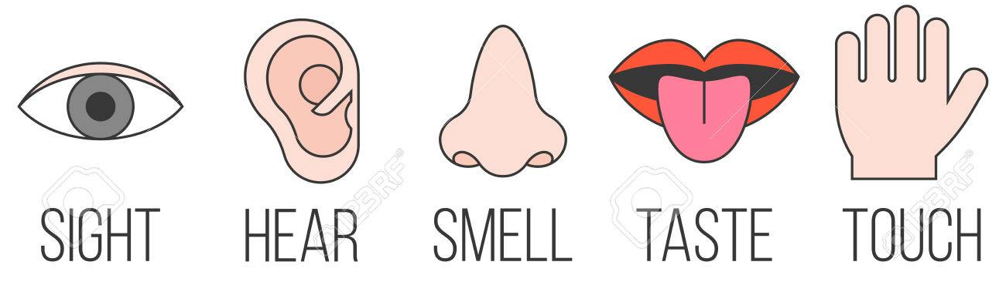
In the rainforest, what can you….
Look at the pictures and listen to the sounds of the rainforest clip on the next slide to help you.
Try to use impressive vocabulary!

Slide 13
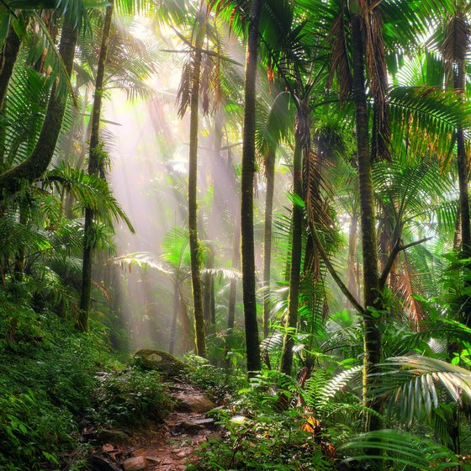
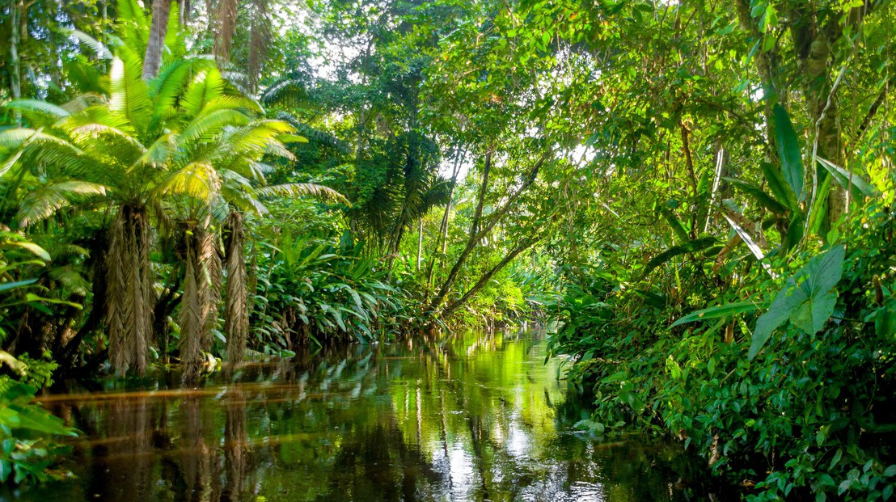
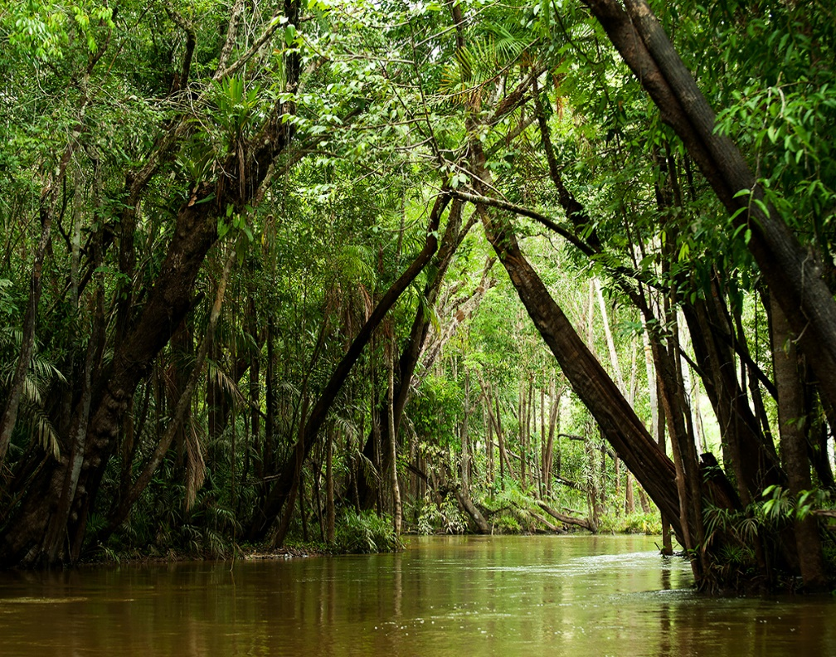
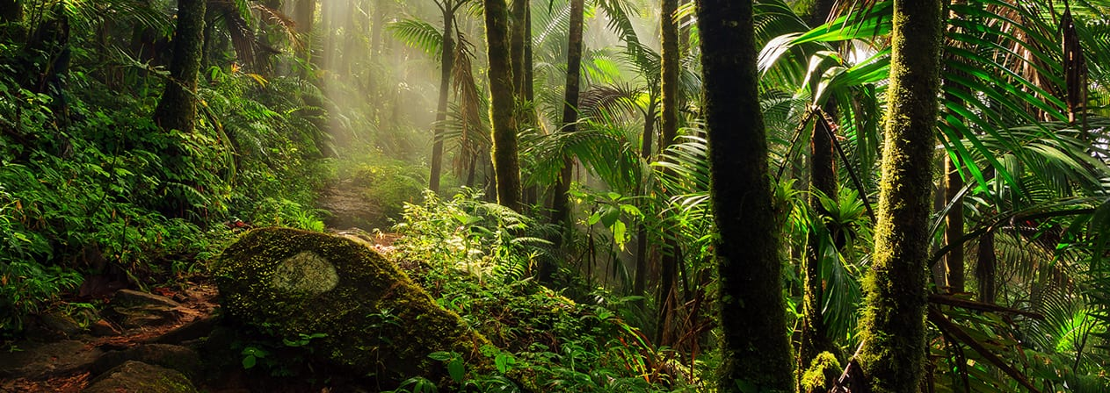
https://www.youtube.com/watch?v=8myYyMg1fFE&t=2712s

Slide 14

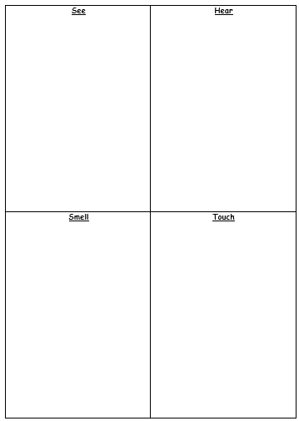
Paddling | Snorkelling | Diving
Independently complete the grid using adjectives. | Complete the grid using expanded noun phrases; remembering to use commas between the adjectives. Challenge yourself to use impressive vocabulary and improve your vocabulary with the help of a thesaurus. | Complete the grid using expanded noun phrases; remembering to use commas between the adjectives. Make sure you are using impressive vocabulary and challenge yourself to use prepositions to add information, e.g. heavy, warm rain dropping softly down my perspiring arm.

Slide 15
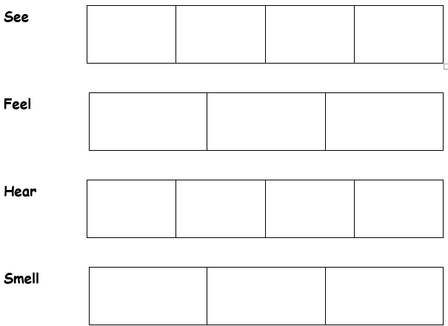
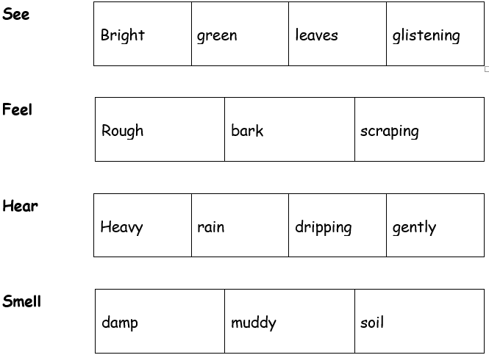
Red Pen
Turn your grids into a 4, 3, 4, 3 poem.
4 words for see
3 words for feel
4 words for hear
3 words for smell
How much description can you fit into your poem?

Slide 16
Wednesday 6th January 2021
LO: to use imaginative description
C: Rainforest Setting

Slide 17
Strong, tangled vines slithered down the rough bark like snakes
The poisonous, curled snake looked like a rope twisted into a knot
The heavy, powerful rain fell like stones
The towering trees were as tall as skyscrapers
What have I written about the rainforest?

Slide 18
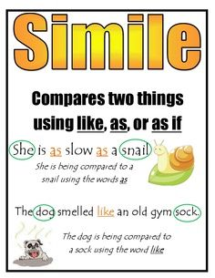
What makes it a simile?
It is important that we use accurate comparisons as this will have the greatest effect on the reader.
e.g. as tall as a pencil
A good smile or not?

Slide 19
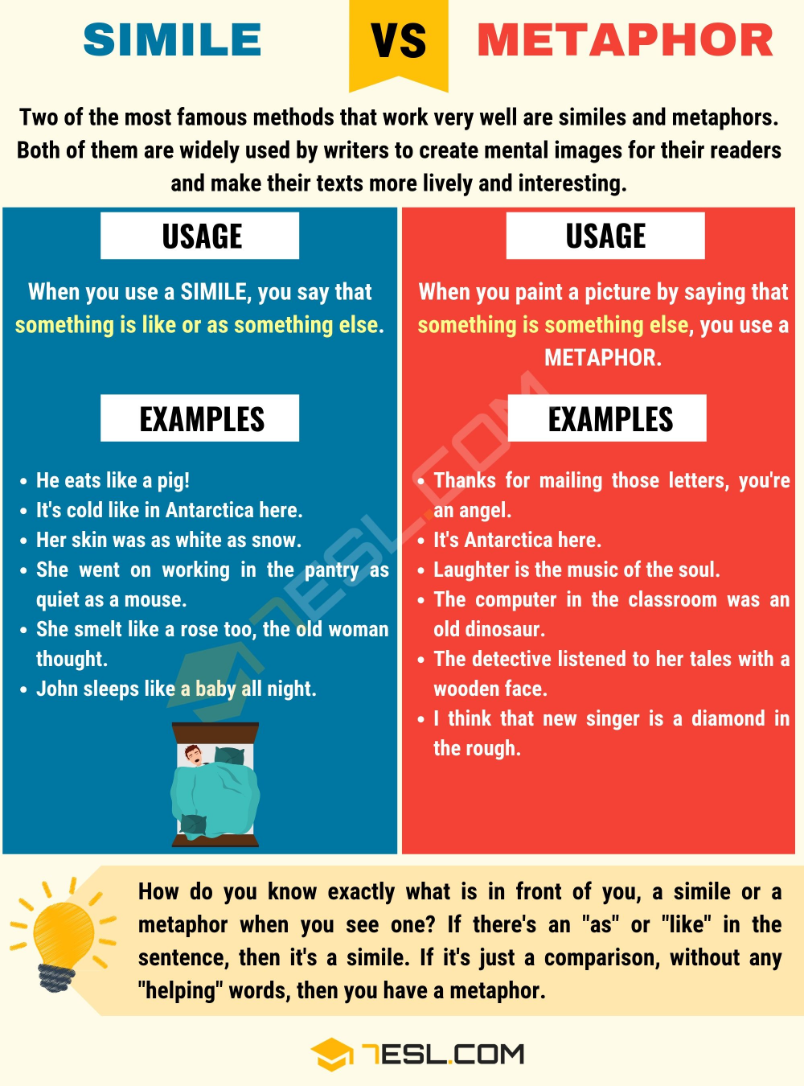
Surrounded by an ocean of towering, sturdy trees
The sun was broken into fragments, scattered all over the rainforest floor.
The trees are giants towering over me.
These are metaphors.
What is the difference between a simile and a metaphor?

Slide 20
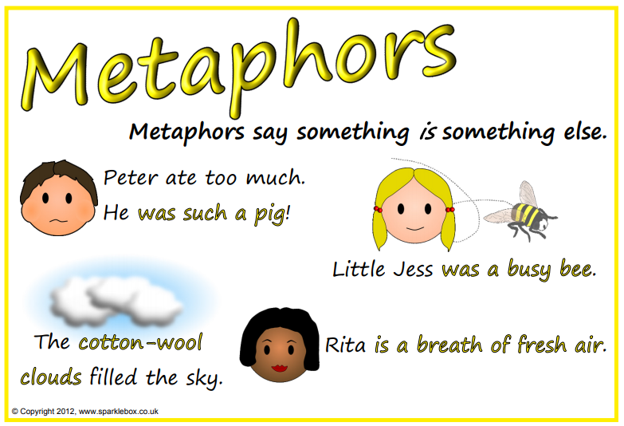

Slide 22
Write down some similes and metaphors to describe the rainforest.
Make sure you know the difference between a simile and a metaphor!

Slide 23
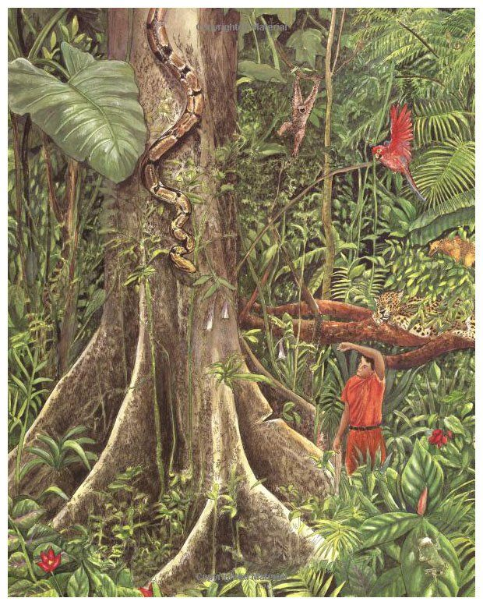
Paddling | Snorkelling | Diving
Annotate the picture of the rainforest from The Great Kapok Tree with similes and metaphors. | Annotate the picture of the rainforest from The Great Kapok Tree with similes and metaphors. Make sure your ideas make sense and your comparisons are accurate. Red Pen: improve your vocabulary using a thesaurus. | Annotate the picture of the rainforest from The Great Kapok Tree with similes and metaphors. Make sure your ideas make sense and your comparisons are accurate. Red Pen: improve your vocabulary using a thesaurus.

Slide 24
Thursday 7th January 2021
LO: to use sentences appropriately
C: Rainforest Setting

Slide 25
The Great Kapok Tree
Two men walked into the rainforest.
The sound of the blows echoed through the forest.
The wood of the trees was very hard.
What do you think about these sentences?

Slide 26
They are simple sentences.
Experienced writers use a variety of sentences to make their writing interesting and lively. Too many simple sentences will sound choppy and boring, while too many long sentences will be difficult to read and hard to understand.
Some simple sentences are good – they can be effective if used with other sentences.
You can use different sentence structures to make your writing sound more interesting and be more engaging.

Slide 27
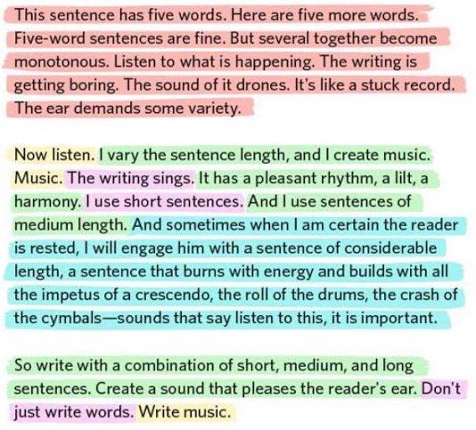

Slide 28

Simple sentences
They are very simple!
They make sense on their own.
They contain a subject, object and a verb.
They only contain one idea.
He handed in his homework.
The whale ate all of the fish.

Slide 29
Compound sentences
This is when you join together two simple sentences using a conjunction.
Both ideas are equally important.
The most common conjunctions used in compound sentences are ‘and’, ‘or’, ‘but’ and ‘so’.
VERY IMPORTANT – both parts of the sentence have to make sense on their own. If you took the conjunction away, the sentences would make sense on their own as simple sentences.
He handed in his homework, but he had forgotten the last page.

Slide 30
Compound sentences
coordinating conjunctions:
and but or
Joins similar things
Shows a choice
Links a contrast or surprise

Slide 31
The whale opened his mouth |  | he swallowed the fisherman
The fisherman was inside the whale |  | he didn’t panic
This story might be true |  | it might be fiction
Which coordinating conjunctions will join the clauses best?
coordinating conjunctions:
and but or

Slide 32
Complex sentences
Complex sentences are made up of a main clause and a subordinate clause.
The main clause is like the simple sentence and it must make sense on its own.
The subordinate clause adds extra information and does not make sense on its own.

Slide 33
Complex sentences
The subordinate clause can come at the beginning of a sentence (fronted adverbial):
When he handed in his homework, he forgot to give his teacher the last page.
The subordinate clause can come in the middle of a sentence:
He handed in his homework, which was missing the last page, to his teacher.
The subordinate clause can come at the end of a sentence:
He handed in his homework, although he forgot to give in the last page.

Slide 34
Does not make sense on its own
Can often move around
Makes sense on its own
Show how ideas relate to each other
main clause subordinate clause
The main clause is the part which will make sense on its own.
This is the important part of the sentence.
The subordinate clause is the part which doesn’t make sense on its own.
It is not as important as it just gives us some extra information.

Slide 35
Subordinating Conjunctions
after although as as if as long as as though because before even if even though | if if only in order that now that once rather than since so that than that | though till unless until when whenever where whereas wherever while
Try to use a range of conjunctions.

Slide 36
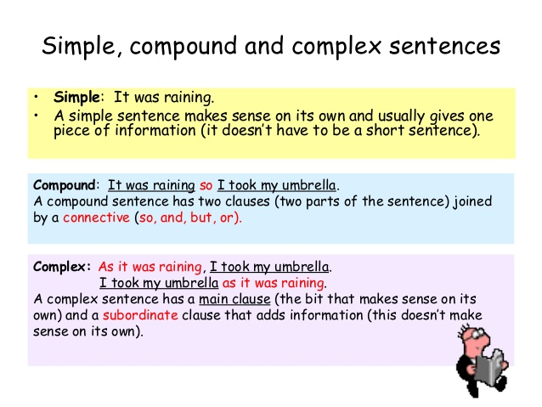

Use a comma before a conjunction in the middle of your sentence.
Use a comma after the subordinate clause, if you are starting a sentence with a subordinate conjunction.

Slide 37
We can improve simple sentences by changing them into compound or complex sentences.
Can you improve these sentences?
Two men walked into the rainforest.
The sound of the blows echoed through the forest.
The wood of the trees was very hard.

Slide 38

Have a go at improving these sentences.
Can you turn them into a compound or complex sentence?
The forest was alive.
The forest was full of the sound of monkeys and birds.
The animals fells silent.
The larger of the two men stopped.
He pointed to the Great Kapok tree.

Slide 39
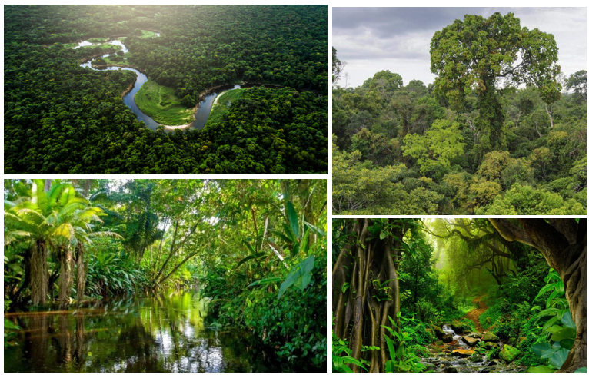
Paddling | Snorkelling | Diving
Using the descriptive work we have done this week, write some descriptive sentences about the rainforest. Try to use compound or even complex sentences! Use the pictures to help you. | Change this paragraph of simple sentences into a paragraph with simple, compound and complex sentences. Two men walked into the rainforest. The forest was alive. The forest was full of the sound of monkeys and birds. Then the animals fells silent. They wondered why the men were here. The larger of the two men stopped. He pointed to the Great Kapok tree. He left. | Using the descriptive work we have done this week, write a paragraph describing the rainforest. Make sure you use a combination of simple, complex and compound sentences.

