Slide 1

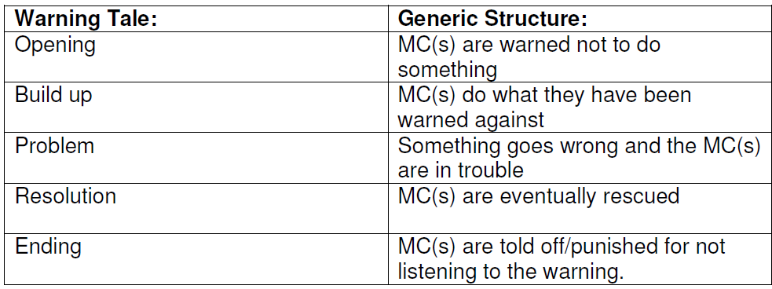

Slide 2
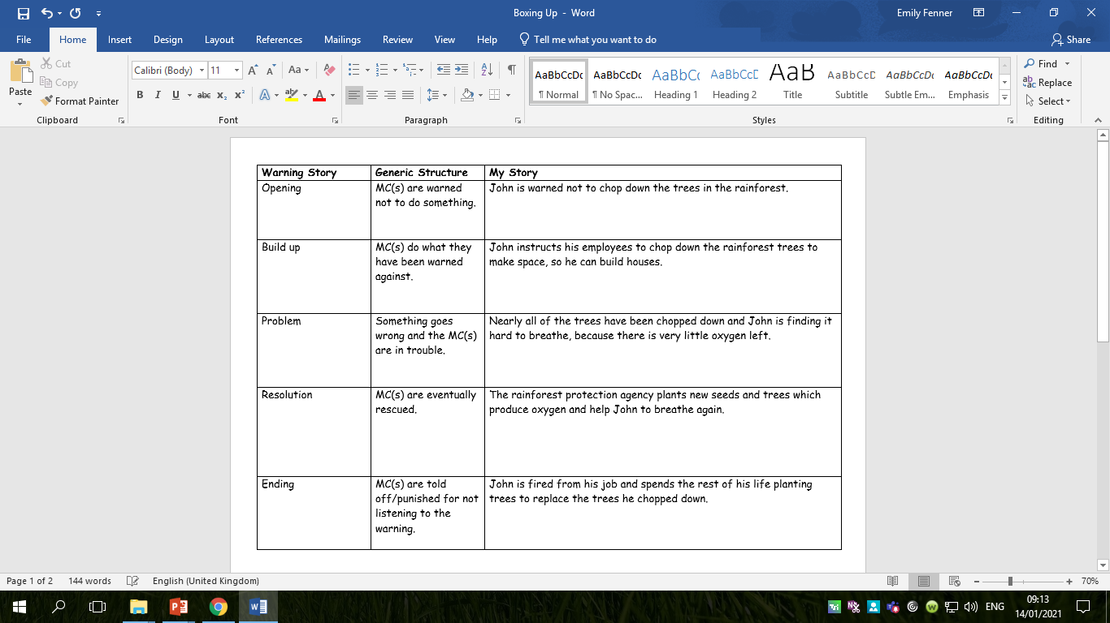

Slide 3
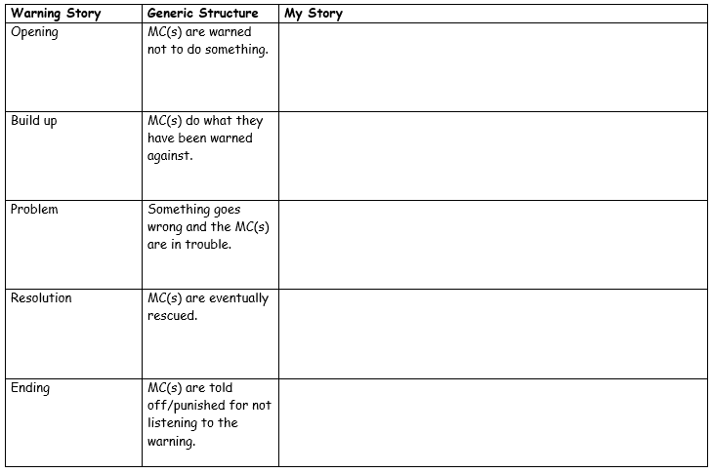
Activity
Box up (plan) your own warning story.
Red Pen: add more details to your plan to help you remember what is happening.

