Slide 1
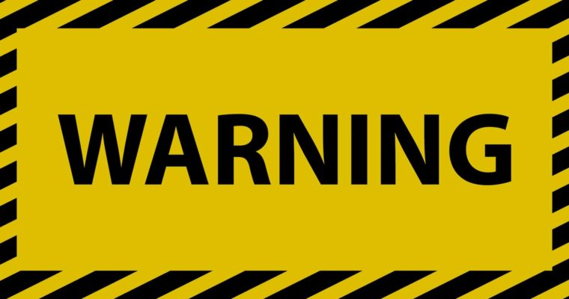


Slide 2
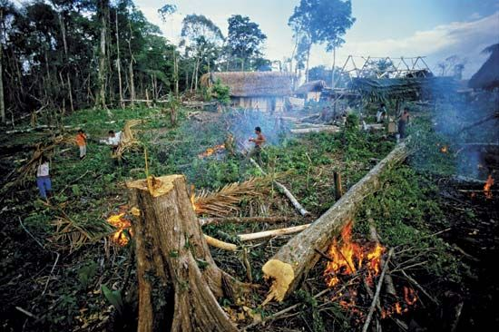
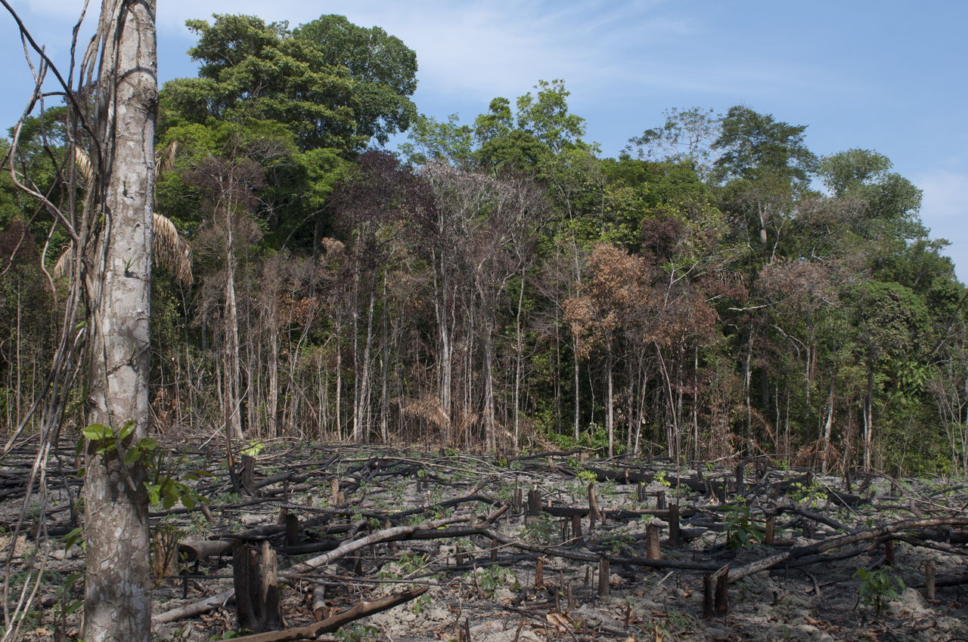
Warn humans not to destroy the rainforests!
What might happen if humans destroy the rainforest?
How might the main character or the rainforests be rescued?

Slide 4

Your story
Who is the main character?
What have they been warned not to do?
Who or what warned them?
Where are they?
What are they doing?
Why are they there?
How are they feeling?

Slide 5
My story:
Who is the main character?
The main character is a young, selfish man called John.
What have they been warned not to do?
He has been warned to stop chopping down the rainforest for space to build homes on.
Who or what warned them?
The rainforest protection agency has warned him.
Where are they?
John is in his smart, expensive office.
What are they doing?
He is telling his employees to chop down all of the trees in the rainforest.
Why are they there?
He is in his office, because he is the boss of a company who builds houses on rainforest land.
How are they feeling?
He is feeling excited, because he is going to sell the houses he builds for lots of money.

Slide 6
Activity
Write down the answers to the questions about your warning story.
Who is the main character?
What have they been warned not to do?
Who or what warned them?
Where are they?
What are they doing?
Why are they there?
How are they feeling?
Red Pen: Read A Caravan again from last lesson and look for any words/phrases you could use in your own warning story. Write these words/phrases in your books under today’s work.

